Slide 1
Corruption
p.vezina@bham.ac.uk

Slide 3
Intro
Corruption is one of the biggest problems facing poor countries
  Read the intro to Economic Gangsters!
How can we measure it?

Slide 4
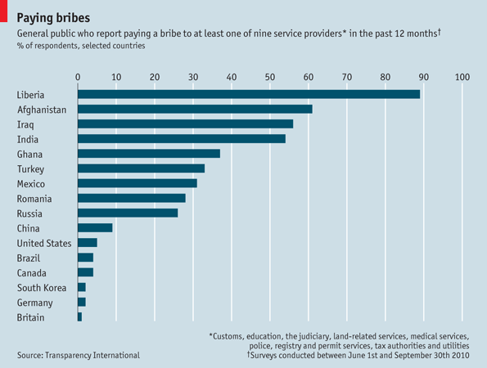

Slide 5
Transparency international
Index based on experts’ perceptions

Slide 6
An increase in the corruption level from that of Singapore to that of Mexico would have the same negative effect on inward FDI as raising the tax rate by fifty percentage points.
Transparency international
Index based on experts’ perceptions

Slide 7
Intro
Corruption is one of the biggest problems facing poor countries
  Read the intro to Economic Gangsters!
  “Abuse of public power for private gain”
How can we measure it?
  Illegal, so under the radar
  Many forms, e.g. grand vs. petty corruption
  Governments stealing oil revenues vs. custom officers extracting bribes
Economists can find traces of corruption in official data

Slide 8
Readings
Economic Gangsters, Chap. 2
Raymond Fisman, 2001. "Estimating the Value of Political Connections," American Economic Review, American Economic Association, vol. 91(4), pages 1095-1102, September.

Slide 9
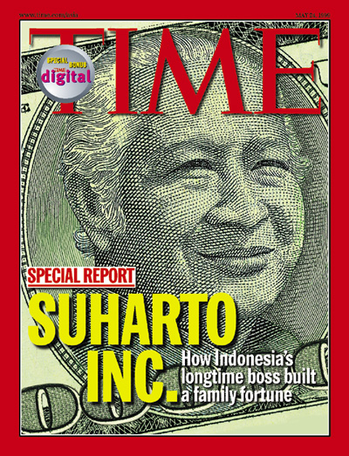
Estimating the Value of Political Connections
Suharto’s influence (1967-1998):
  “Dictated who would make money”
  Allocated subsidies and trade protection to promote strategic industries
  Provided low-interest loans through gov-owned banks
  Presided over a host of licensing restrictions to decide who can:
    Grow oranges
    Roll cigarettes
    Cut down trees
    Build toll roads
    Import rice…

Slide 10
Estimating the Value of Political Connections
President Suharto is known as "Mr. Ten Percent“
Foreign corporations doing business there are expected to pay a relatively well-defined bribe to the president or members of his family
Yet, Indonesia was/is a popular destination of FDI, particularly from Japan

Slide 11
Estimating the Value of Political Connections
Indonesian economy went into a downward spiral in 1997
  Massive outflow of foreign capital
The claim was that political connectedness, rather than productivity, was the determinant of profitability
  This had led to distorted investment decisions

Slide 12
Estimating the Value of Political Connections
Is connectedness really a determinant of firm profits?
  The business dealings of President Suharto's children were often cited as evidence
  Suharto family members had a reputation for demanding a cut of any company wanting to do business with the government

Slide 13
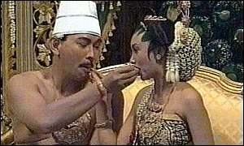
Estimating the Value of Political Connections
Mandala Putra Suharto, aka Tommy
  Driving around Jakarta in Rolls Royce
  Multimillion vacation homes scattered across the globe
  Playboy indulgences
Where did he get the cash?
  Corporate empire covering every facet of Indonesia's economy
    Cigarettes, television broadcast, automobiles
    His companies make products and his share is huge

Slide 14
Estimating the Value of Political Connections
Two questions:
  Which firms are politically connected?
  Are connections really key to profits?

Slide 15
Estimating the Value of Political Connections
Two questions:
  Which firms are politically connected?
Suharto Dependency Index (1995) developed by the Castle Group, a consulting firm in Jakarta
  Numerical rating of the degree to which each of the 25 largest industrial groups in Indonesia is dependent on political connections
  Most of these groups have multiple companies listed on the Jakarta Stock Exchange, yielding a sample of 79 firms
  Companies affiliated with Suharto's children received a score of 5, as did those owned by longtime Suharto allies

Slide 16
Estimating the Value of Political Connections
Two questions:
  Are connections really key to profits?

Slide 17
Estimating the Value of Political Connections
Two questions:
  Are connections really key to profits?
  Connected companies may perform better, but that may be because they ARE better, not because of their connections
  We need to know what happens when these companies lose their connection
  This is revealed by stock market reactions to Suharto’s health
    (Stock prices are a measure of a firm’s future profits)

Slide 18
Estimating the Value of Political Connections
  4 July 1996
News that Suharto is traveling to Germany for a health check up
Rumours of stroke, surgery

Slide 20
“whenever Mr Suharto catches a cold, shares in Bimantara Citra catch pneumonia”

Slide 21
Estimating the Value of Political Connections
  Bad news about Suharto’s health suggest a possible end to political connections
  Investors start thinking that firms that benefitted from these connections won’t do as well without them
  So what is the value of connections?

Slide 22
Estimating the Value of Political Connections
Rumour events about Suharto's health determined by a search for the keywords SUHARTO, HEALTH and INDONESIA, and (STOCK or FINANCIAL) were used in a Lexis-Nexis literature search.
  484 stories → 6 episodes (1995-1997)

Slide 24
Politically dependent firms, on average lost more value during these episodes than did less-dependent firms

Slide 25
Estimating the Value of Political Connections
6% of expected profits of well-connected companies disappeared overnight because of a health check up
When apple announced the iPhone in 2006, stocks went up 8%
➔ The value of political connections is almost as high as introducing the iPhone

Slide 26
  Investors foresaw the trip 2 days before. How?

Slide 27
Estimating the Value of Political Connections
    Investors knew stocks would dive
      Did Suharto’s doctor tell them?
    Well connected investors knew
      Insider trading gets the ball rolling

Slide 28
Estimating the Value of Political Connections
The end...
Tommy Suharto corruption trial opens (BBC News)

Slide 29
Estimating the Value of Political Connections
What about connections in other countries?
Mara Faccio looked at 20,202 publicly traded firms in 47 countries
A company is connected if at least one of its large shareholders (anyone controlling at least 10% of voting shares) or one of its top officers (CEO, president, vice-president, chairman, or secretary) is a member of parliament, a minister, or is closely related to a top politician or party
Political connections widespread; they exist in 35 of the 47 countries

Slide 32
Estimating the Value of Political Connections
UK vs. Italy
When Rolls-Royce chairman Sir John Moore was appointed to House of Lords, no detectable effect on Rolls Royce stock price
When Fiat boss Giovanni Agnelli was appointed to the Italian Senate, Fiat’s stock price increased by 3.4%

Slide 33
Estimating the Value of Political Connections
In the US?
No systematic evidence of the value of connections but…
Dick Cheney left Halliburton to join the Bush administration
  US gov gave Iraq contract to… Halliburton

Slide 34
Estimating the Value of Political Connections
He has gained notoriety as one of Africa’s most extravagant spenders and for his jet-setting playboy lifestyle.
He owns two lavish homes in Cape Town and a $30 million mansion in Malibu, California.
In 2006, he reportedly spent $1.5 million on two Bentleys – an Arnage T and a Mulliner – and a Lamborghini Murcielago as well as two luxury houses.
He once dated rapper Eve and in 2006 he staged a Christmas party for her aboard Tatoosh, the 300-foot yacht owned by Microsoft co-founder Paul Allen. He reportedly spent about $400,000 to rent the boat.
In February, French authorities seized his six-story mansion on Avenue Foch in Paris, which contained paintings by famous artists and a vintage clock worth about $5 million.
His US assets include a Gulfstream jet, yachts, cars, and nearly $2 million in Michael Jackson memorabilia including pairs of crystal-covered socks.
Forbes

Slide 35
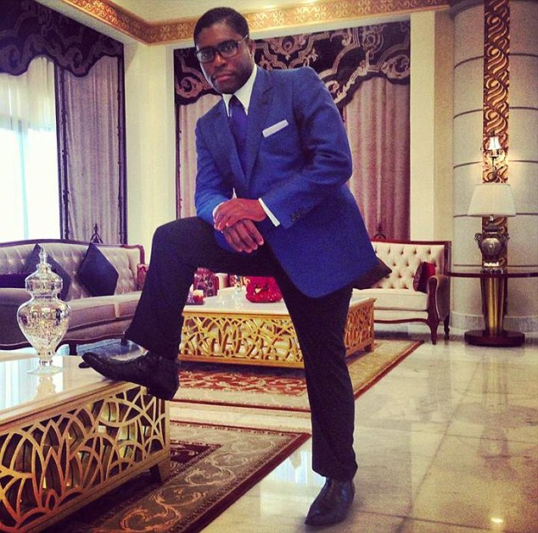
Estimating the Value of Political Connections
"Teodorín" Obiang
Son of President of Equatorial Guinea
President Obiang's family steals pretty much all of the country's oil revenues and has received huge bribes from US oil companies such as Exxon Mobil and Amerada Hess...

Slide 36
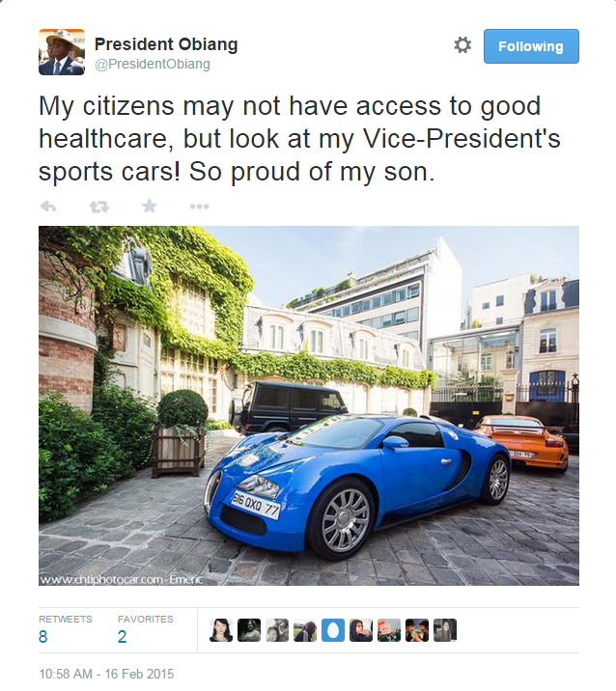

Slide 37
Estimating the Value of Political Connections
The power of the street in Egypt’s Arab Spring
Protest against the political arrangements benefiting connected individuals and firms
Are they effective at limiting the extent of corruption and favouritism that set them off?

Slide 38
Estimating the Value of Political Connections
On 11 February 2011, Hosni Mubarak, Egypt's president and dictator since 1981, was forced to resign in the face of large protests in the main square of Cairo, Tahrir Square
Mubarak's fall was followed by:
  Military rule until June 2012
  Mohammed Mursi, an Islamist, as President
  A second phase of military rule starting in July 2013.
  ➔ A window to study the real-time effects of street protests against a changing cast of ruling political elites

Slide 39
Estimating the Value of Political Connections
Construct a daily estimate of the number of protesters in Tahrir Square
  Using information from Egyptian and international print and online media

Slide 40
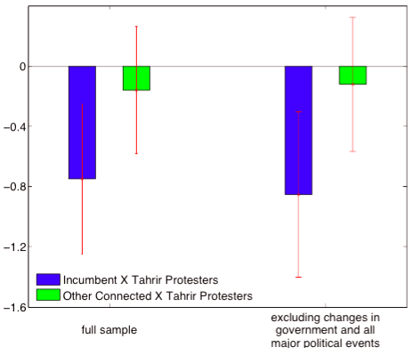
Effect of 500,000 protesters in Tahrir Square on the daily stock returns of firms connected to the incumbent regime (blue bar) and rival connected firms (green bar), relative to non-connected firms.

Slide 41
Estimating the Value of Political Connections
Under Mubarak, significant effect of protests on the relative valuation of NDP-connected firms, but no effect on military and Islamic-connected firms
Under military rule, protesters harm the valuation of military-connected firms, but not the valuation of their rivals.
When Islamists are the target of the protests, bigger protests harm Islamic firms but have no effect on NDP- and military-connected firms

Slide 42
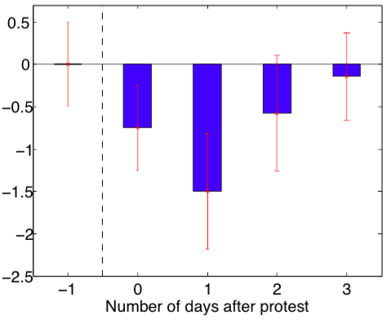
Effect of 500,000 protesters in Tahrir Square on the daily stock returns of firms connected to the incumbent regime before and after the day of the protest.

Slide 43
Readings
Economic Gangsters, Chap. 3
Raymond Fisman & Shang-Jin Wei, 2009. "The Smuggling of Art, and the Art of Smuggling: Uncovering the Illicit Trade in Cultural Property and Antiques," American Economic Journal: Applied Economics, vol. 1(3), pages 82-96, July.

Slide 44
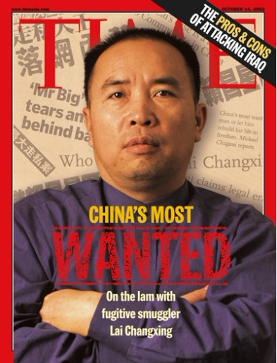
Smuggling
The Greatest Smuggler in modern history
Smuggled $6 billion of merchandise from Hong Kong to China

Slide 45
Smuggling
He smuggled tobacco, gasoline, luxury cars, TVs, and other high-tariff items
  Goods not illegal in themselves
  But he imported them without paying import tariffs

Slide 46
Smuggling
Suppose he wanted to import 1,000 frozen chickens
Need to find a way around paying 20% tariff
  Lie about the chickens value (5 yuan instead of 10)
    But what if the custom agents knows that chicken are worth 10 yuan?
  Lie about the number of chickens (500 instead of 1000)
    Same risk, especially if container is weighted
  Lie about the chickens (call them turkeys instead)
    Turkeys only face a 10% tariff

Slide 47
Smuggling
How did he manage that trick?
  By bribing custom officials
    Seemingly half of custom officials in China were on his payroll
  And the risk of detection is low
    24 million 40-foot containers passed through Hong Kong in 2006
    2700 every hour
    Custom agents can’t examine the contents of all of them

Slide 48
Smuggling
How can economists measure such type of smuggling?
  Look at anomalies in official trade statistics
  The trade gap: Difference between what exporters and importers report
  Lai Changxing left holes of this sort in the Hong Kong-China trade numbers
    Hong Kong declared exports of cigarettes and cars and these never arrived in China

Slide 49
Smuggling
China’s tariffs
  Perfume: 55%
  Tobacco: 70%
  TVs: 50%
  Cars: 100% or higher
The higher the tariff, the more incentive to smuggle and avoid tariff duties
  The trade gap is much higher for high-tariff goods
  If tariff is 1 percentage point higher, the gap rises by 3 percentage points

Slide 51
Smuggling
Policymakers set different tariffs across goods precisely to create incentives for corruption
This means they can fill their pockets
  Abuse of public power for private gain

Slide 53
Smuggling
FedEx warns on its website (2010) that Chinese “customs officials still have wide discretion concerning the category in which an import is placed [and have] the flexibility […] to "negotiate" duties.”

Slide 54
Smuggling
Nepal bans airline staff pockets (BBC News)
Staff at Nepal's main international airport are to be issued with trousers without pockets, in an attempt to wipe out rampant bribe-taking.
A spokesman said trousers without pockets would help the authorities "curb the irregularities".

Slide 55
Smuggling
Declare rice as mung beans
Two Philippine companies, Plum Blossom Import-Export Food Corp. and Full Story Source Marketing were apparently importing rice from Vietnam and Thailand but misdeclaring it as mung beans. Why?
White rice imports require an import license from the National Food Authority and are subject to a 50% duty and 12% VAT. Mung beans, meanwhile, are zero-rated in both customs duties and VAT under the ASEAN Free Trade Agreement.

Slide 56
Smuggling
Undervalue motorcycles:
48 brand new Yamaha motorcycles arrived at the Port of Manila in December 2013
According to import documents, the motorcycles were "in knocked-down condition" from Thailand, and valued $212 each
Customs inspection found the motorcycles were new and came from India
The suggested selling price of a brand new Yamaha in India is $1,812, about 85% higher than the declared value

Slide 57
Smuggling
Recap
High and varying tariffs create incentives for evasion and corruption
This leaves traces in official statistics
  Economists can identify smuggling in the trade gap’s correlation with tariffs

Slide 58
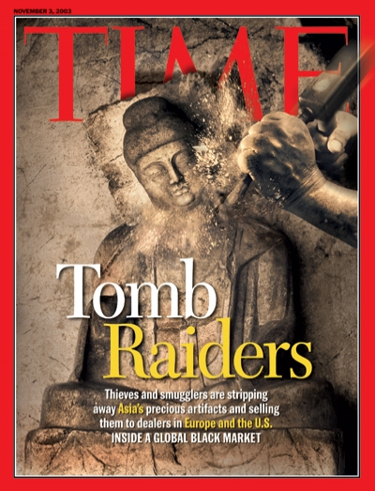

Slide 59
Smuggling
Countries ban or restrict export of antique art and cultural property
  Etruscan chariots
  Greek statues
  Pre-Columbian pottery
  19th century coins
  The US welcomes them
    Violating a foreign law doesn’t mean you’re violating US law
    Zero tariff rate on antiques and cultural objects
  More antiques arrive in the US than leave other countries
    Activities are facilitated through the bribing of customs officials to look the other way

Slide 60
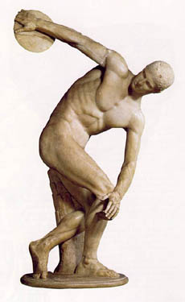
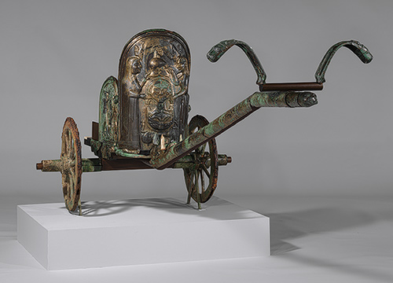
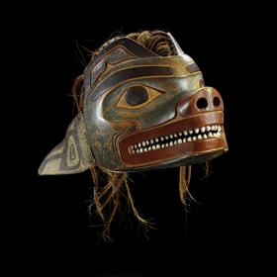
Smuggling

Slide 62
Smuggling
Why is this correlation questionable?

Slide 63
Smuggling
Why is this correlation questionable?
  Poor countries have poor custom records
  Corrupt countries have more antiques

Slide 64
Smuggling
Why is this correlation questionable?
  Poor countries have poor custom records
The authors run a placebo test
  Instead of antiques, they look at toys
  They observe no correlation between an exporter's corruption level and the trade gap in toys
Results cannot be explained by poor customs records since this should affect trade data for toys and antiques equally

Slide 65
Smuggling
Why is this correlation questionable?
  Corrupt countries have more antiques
    They control for the amount of antiques a country has
    Look at the number of works at the New York Met
      Countries with more antiques are a bigger part of the museum’s collection

Slide 66
Smuggling
In general, trade gap is not a perfect measure of smuggling
Too noisy as a measure of evasion
  It includes shipping costs, exchange-rate mistakes, and omissions
We can uncover illegal behaviour in its correlation with trade barriers and corruption

Slide 68
Smuggling
Apart from antiques, any other goods face export barriers?

Slide 69
Smuggling
About one-third of all export taxes cover natural resources
Countries restrict the export of natural resources to
  lower domestic prices
  promote downstream industries
  earn rents on international markets
  on environmental grounds

Slide 71
Exports are more likely to be missing when there is an export barrier and when corruption is high

Slide 72
Smuggling
The Economist (2014) describes a massive scam in India
  A mafia made profits of about $2 billion shipping illegal iron ore to China
  The bank details found on computers taken into custody created a trail of 70 families who had bribed officials and politicians to make the exports possible.

Slide 73
Smuggling
Should the importing country ban imports of illegal exports?
  Of resources or antiques?
One such example is the US Lacey Act of 1900, amended in 2008 to make it unlawful to import, export, transport, sell, receive, acquire, or purchase in interstate or foreign commerce any plant in violation of any foreign law that protects plants.
The Lacey Act was invoked in a 2009 raid on Gibson which was using hardwoods that had been illegally exported from Madagascar for its guitar manufacturing

Slide 74
Smuggling
Recap
  Economists can identify illicit in official trade statistics
  Trade barriers must exist in only one of the 2 trade partners
    In the exporter (e.g. ban on antiques)
    In the importer (e.g. tariffs)
  This creates a trade gap
  The trade gap’s correlation with trade barriers captures illicit trade
    This is confirmed by its correlation with corruption

Slide 75
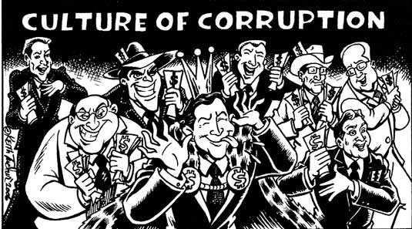
Corruption: Evidence from Diplomatic Parking Tickets

Slide 76
Readings
Economic Gangsters, Chap. 4
Raymond Fisman & Edward Miguel, 2007. "Corruption, Norms, and Legal Enforcement: Evidence from Diplomatic Parking Tickets," Journal of Political Economy, University of Chicago Press, vol. 115(6), pages 1020-1048, December.

Slide 77
Corruption: Evidence from Diplomatic Parking Tickets
Why are some countries corrupt and others law-abiding?
In some countries
  Cops expect you to pay bribes when they pull you over
  You need to pay bribes to get running water, a driving license, a phone line

Slide 79
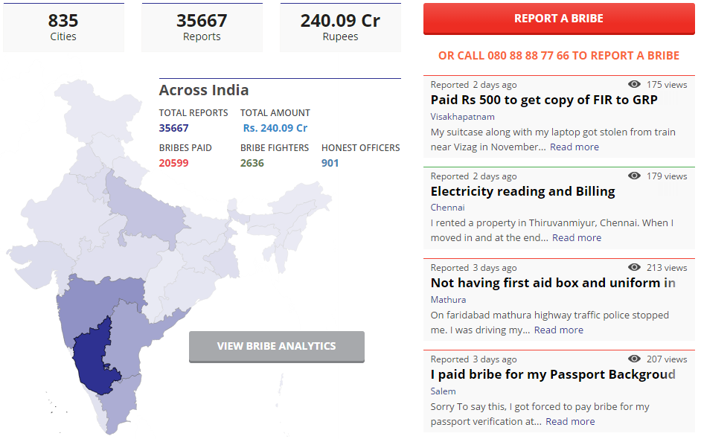
ipaidabribe.com

Slide 80
Corruption: Evidence from Diplomatic Parking Tickets
Are cultural differences behind these cross-country differences in corruption?
Or is it weak law enforcement?
  What if we put “clean” Norwegians in a weak legal enforcement environment?

Slide 81
Corruption: Evidence from Diplomatic Parking Tickets
How can we measure the relative importance of legal incentives and cultural norms?
We need various cultures
  ➔ Diplomats working at the United Nations in New York
Under one legal framework
  ➔ Parking enforcement (NY “law”)

Slide 82
Corruption: Evidence from Diplomatic Parking Tickets
Diplomats can be issued parking tickets
But don’t have to pay them
➔ Diplomatic immunity

Slide 83
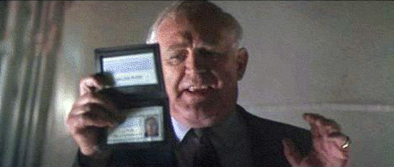
Corruption: Evidence from Diplomatic Parking Tickets
Lethal Weapon II
South African Diplomat runs drug smuggling out of LA’s consulate
Protected from federal prosecution by flashing his ID and reciting the phrase “diplomatic immunity”
“My dear officer, you could not even give me a parking ticket”
WikiLeaks

Slide 84
Corruption: Evidence from Diplomatic Parking Tickets
Diplomats can be issued parking tickets but don’t have to pay them
  Why would diplomats pay them?
  Why would they park illegally in the first place?
  A matter of moral (or culture) rather than legal sanction
Unpaid fines are a good approximation of corruption (the abuse of public power for private gain)

Slide 85
Corruption: Evidence from Diplomatic Parking Tickets
Which “cultures” abuse the most?

Slide 86
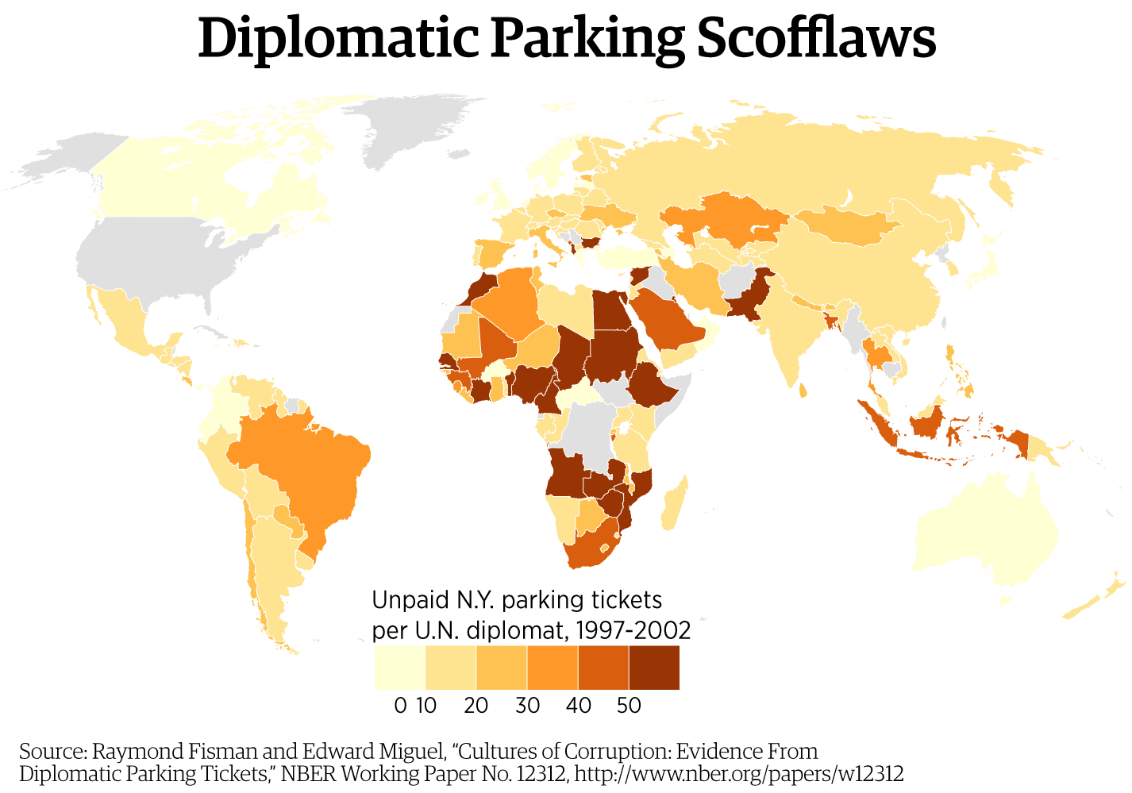

Slide 87
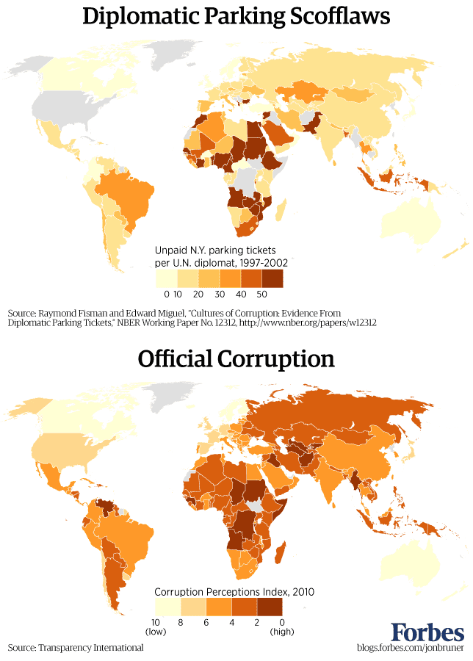

Slide 90
Corruption: Evidence from Diplomatic Parking Tickets
Is this correlation questionable?
  Does it tell us that culture explains corruption?

Slide 91
Corruption: Evidence from Diplomatic Parking Tickets
Is this correlation questionable?
Omitted variable?
Maybe poorer countries are more corrupt and their diplomats can’t afford to pay the fines?
  The authors control for GDP per capita
  They also show that unpaid tickets are not only due to work-related parking

Slide 92
Ambassador X from Kuwait
Arrived in NY in April 1999
  249 unpaid tickets in 1999
  526 in 2000 ➔ 10 per week!
  351 in 2001
Not just around UN
  Also in Greenwich village and Upper East Side
  Fine wining and dining

Slide 93
Corruption: Evidence from Diplomatic Parking Tickets
Diplomats from countries with low levels of corruption behaved well, even when they could get away with breaking the rules.
  Invitation to be corrupt → “No, thanks.”
The culture of their home country was imported to New York, and they acted accordingly.
So culture matters in explaining corruption… BUT

Slide 94
Corruption: Evidence from Diplomatic Parking Tickets
So does legal enforcement:
Over time, diplomats from “clean” countries did cheat more, as they learned how the system worked
And then… legal enforcement changed

Slide 95
Corruption: Evidence from Diplomatic Parking Tickets
In 2002 Chuck Schumer and Hillary Clinton, New York's senators, added an amendment to a foreign-aid bill
NY could deduct unpaid parking tickets from foreign-aid disbursements to offending countries

Slide 97
If you can enforce laws, you can reduce corruption

Slide 98
Corruption: Evidence from Diplomatic Parking Tickets
Fisman and Miguel also found that countries where the US is viewed unfavourably tended to accumulate more unpaid
  “Stick it to the man”
Diplomatic parking violations plummeted during the brief spike in international goodwill that the US enjoyed just after 9/11

Slide 99
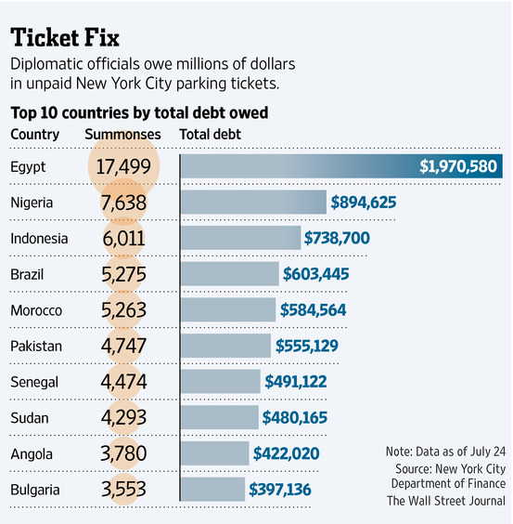

Slide 100
Corruption: Evidence from Diplomatic Parking Tickets
COUNTRY | NUMBER OF FINES | TOTAL OUTSTANDING
USA | 70,637 | £ 8,172,245
Japan | 48,520 | £ 5,623,040
Russia | 44,145 | £ 5,123,450
Nigeria | 39,604 | £ 4,552,745
Germany | 34,051 | £ 3,928,680
India | 28,069 | £ 3,316,770
Poland | 23,170 | £ 2,725,275
Ghana | 21,156 | £ 2,488,300
Sudan | 20,307 | £ 2,282,505
Kazakhstan | 15,757 | £ 1,868,295
What about diplomats in London?
UK Gov: Value of unpaid parking fines and Congestion Charge debt incurred by diplomatic missions and international organisations in London since its introduction in Feb 2003 until 31 Dec 2013

Slide 101
Corruption: Evidence from Diplomatic Parking Tickets
During a visit by Obama in 2011, London's Mayor Boris Johnson asked him for a £5m cheque for unpaid congestion charges
The US ambassador intervened before Mr Obama could answer, the Daily Telegraph reported.

Slide 102
Corruption: Evidence from Diplomatic Parking Tickets
A similar study
Researchers from Indiana University teamed up with the US Treasury to examine cases of corporate tax evasion.
270,000 IRS corporate tax audits from 1996 to 2007
A firm’s tax evasion = the amount of positive adjustment to the firm’s tax liability following audit.

Slide 103
Corporations with owners from countries with higher corruption engage in tax evasion in the US

Slide 104
Can women eradicate corruption?
Women are more risk-averse than men while making investment decisions
A higher share of women in the labour force is associated with lower levels of corruption perception in a country
Negative relationship between the share of women in parliament in a country and corruption
Firms with female owners or managers are less likely to offer bribes
Women are less likely to be corruption victims
Link

Slide 105
Can women eradicate corruption?
In 1998, Fujimori announced that Peru’s traffic police force would become an all female force
In 2003 the Mexican Customs Service hired only women for a new anti-corruption surveillance force
In Uganda, President Museveni assigned the majority of positions as treasurer to women as this could curb misspending as women “tend not to be so opportunistic”
Indian villagers are less likely to pay bribes in villages where the chief is a women (in some states, the position is reserved for women by a federal policy).

Slide 106
Corruption
How to fight corruption?
  Remove red tape as these create a need for “speed money”
    Lower and harmonize import tariffs
    Remove the need for licenses to do business
    Reduce the number of docs you need to open a business
    Etc…

Slide 107
Corruption
How to fight corruption?
  Law changes don’t happen
    Those who could change laws are the ones who benefit from regulations and bribes
  Moreover, not all countries have the capacity to enforce laws like NY
Read Chap. 8 of Economic Gangsters

Slide 108
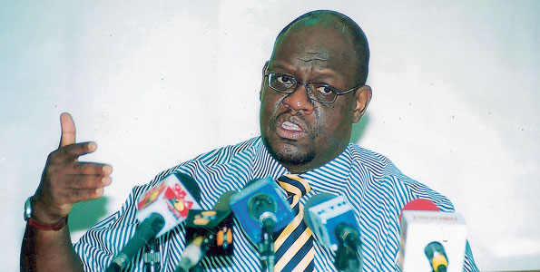
Corruption
Read the Epilogue of Economic Gangsters
John Githongo
  A Kenyan journalist who investigated bribery and fraud
  Under the presidency of Kibaki, he became Head of Ethics and Governance in the Kenya government, charged with rooting out corruption
  About a year into his job, he was told to back off by senior ministers

Slide 109
Corruption
What happened?
He wanted to expose the President’s complicity in a huge corruption scandal
The Kenyan government wanted to replace its passport system in 1997
Sophisticated passport equipment system was originally quoted at €6 million from a French firm, but was awarded to a British firm, Anglo Leasing Finance, at €30 million, who would have sub-contracted the same French firm to do the work
Anglo Leasing Finance was a phantom entity used to steal money from Kenyan taxpayers through massive overpricing

Slide 110
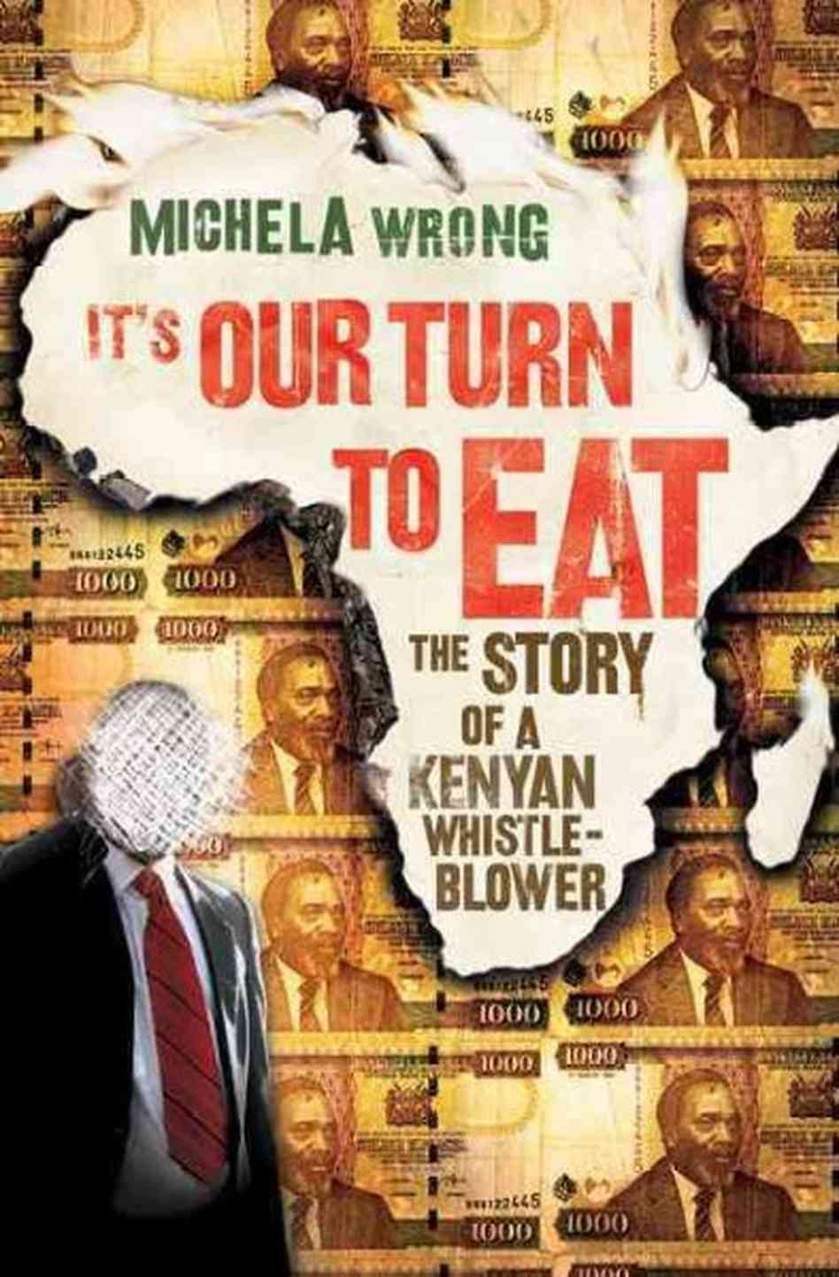
Corruption
  He was then forced to flee the country as he received death threats
  Check out this book ➔➔➔
  He’s now back in Kenya doing what he can…

Slide 111
Corruption
How to fight corruption?
A more piecemeal approach?
    Pocketless pants
    Mimes
    Zero rupees
    Cameras in cars
    Insights from Sumo

Slide 112
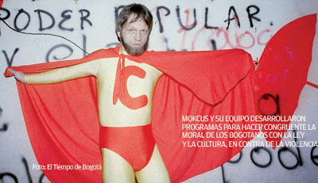
Mimes in Bogota
Mockus, mathematician and philosopher
With no political experience, ran for mayor of Bogotá
Read about him here.

Slide 113
Mimes in Bogota
The city was choked with violence, lawless traffic, corruption, and gangs of street children who mugged and stole.
In his fight against corruption
  He closed down the transit police because many of those 2,000 members were notoriously bribable.
  He hired 20 professional mimes to control traffic in Bogotá's chaotic and dangerous streets.

Slide 114
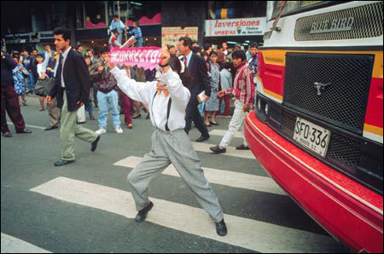
Mimes in Bogota
  They shadowed and mocked pedestrians who didn't follow crossing rules and poked fun at reckless drivers.
Traffic fatalities fell by more than 50%
And there’s no report of mimes taking bribes!
The program was so popular that another 400 people were trained as mimes.

Slide 115
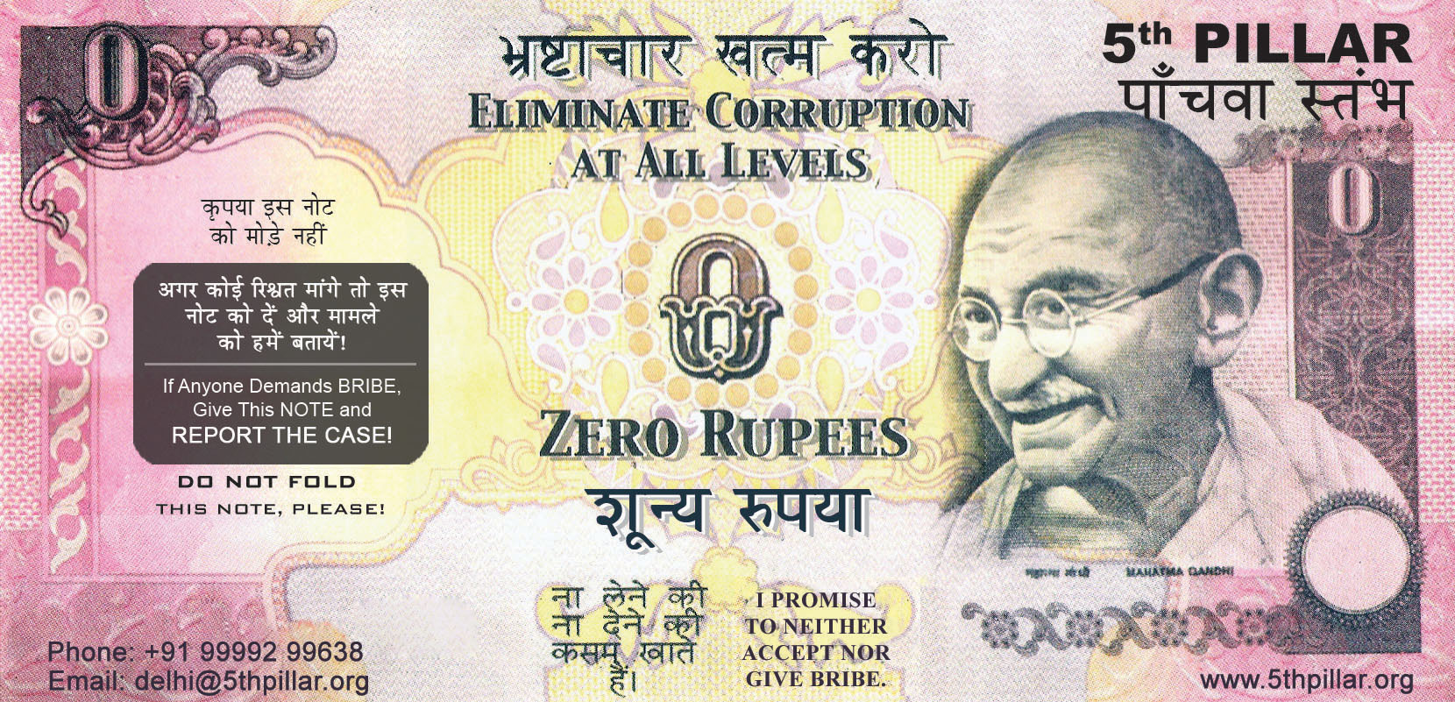
Zero rupees

Slide 116
Zero rupees
Indian NGO thought of a new tool to fight corruption: zero rupee bills.
The idea was dreamt up by an Indian physics professor from the University of Maryland who, travelling back home, found himself harassed by endless extortion demands.
He gave the notes to the importuning officials as a polite way of saying no..."
There are now one million notes in circulation.
Apparently, according to this article, it works.

Slide 117
ipaidabribe.com

Slide 118
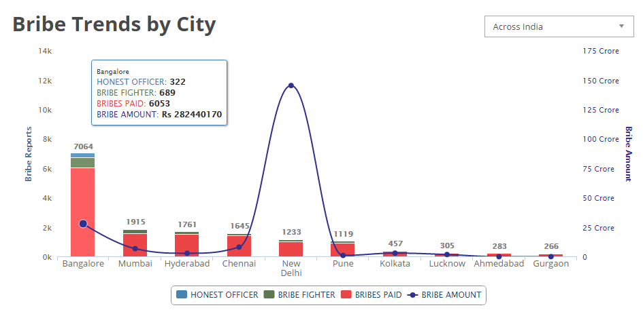

Slide 119
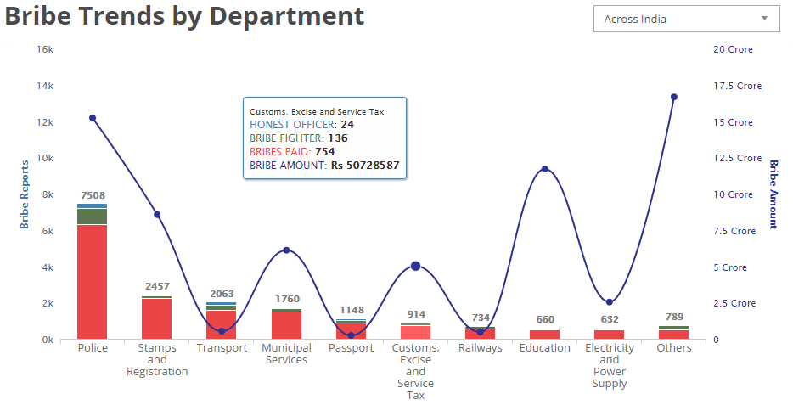

Slide 120
Cameras in cars in Russia
How is it possible that a dozen different motorists around the Russian city of Chelyabinsk were able to capture video of a massive meteor flying through the sky?

Slide 121
Cameras in cars in Russia
Because almost everyone in Russia has a dash-mounted video camera in their car.
One reason: ensuring justice when it comes to proving accidents on the roads.
If police officers are only on the roads to take bribes, bending traffic laws—or ignoring them completely—to benefit themselves.
  A camera will save you from false accusations.

Slide 122
Insights from Sumo Wrestling
"Winning Isn't Everything: Corruption in Sumo Wrestling"
If corrupt practices thrive in Sumo, no institution is safe.
Sumo wrestling is the national sport of Japan
  a 2,000-year tradition
  a focus on honour, ritual, and history

Slide 123
Insights from Sumo Wrestling
The key feature that makes it ripe for corruption is a sharp nonlinearity in the payoff function for wrestlers.
  A tournament involves 66 wrestlers palying 15 matches.
  A wrestler who achieves a winning record (8 wins or more, known as kachi-koshi) is guaranteed to rise up the official ranking

Slide 124
  A wrestler’s rank is a source of prestige and basis for salary determination

Slide 125
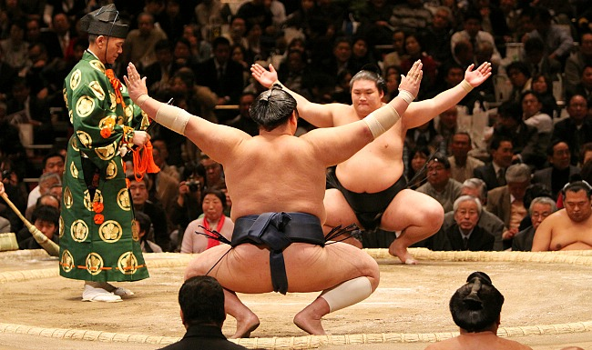
Insights from Sumo Wrestling
Wrestler entering the final match of a tournament with a 7-7 record has far more to gain from a victory than an opponent with a record of 8-6 has to lose.

Slide 126
Red gain much bigger than blue loss
  A wrestler’s rank is a source of prestige and basis for salary determination

Slide 127
26% of all wrestlers finish with exactly 8 wins, compared to only 12.2% with 7wins.

Slide 128
26% of all wrestlers finish with exactly 8 wins, compared to only 12.2% with 7wins.

Slide 129
Insights from Sumo Wrestling
Those wrestlers who are on the margin for achieving the eighth win may exert greater effort because their reward for winning is larger.
Yet match rigging disappears during times of increased media scrutiny

Slide 130
Insights from Sumo Wrestling
Removing this distortion to incentives (the non-linearity) would eliminate the benefits of corruption.
  The same way removing varying tariffs
Match rigging appears to be sensitive to the costs of detection.
  Increased media scrutiny alone is sufficient to eliminate the collusive behaviour.

Slide 131
Outro: Does corruption really matter?
There is only one brewery in Madagascar: Three Horses Beer (THB).
  Pilsner, a tad sweet, a bit chemical.
A brewer from Mauritius tried to enter the market.
  It built a new brewery outside the capital
  Started a massive ad campaign to launch its beer.
  Two days before the opening of the factory, two official documents were missing and the factory could not start producing.
  Rumour has it THB gave a €2 million bribe to government officials to retain the beer monopoly.
  Corruption ⬄ Only one beer brand

