Slide 1
Hecksher-Ohlin Model
Pierre-Louis Vézina
p.vezina@bham.ac.uk

Slide 2
Drawbacks of the Ricardo Model
Since there is only one factor of production (labour), if a country gains, all individuals in that country gain
All agents gain from trade! Is this too great to be true?
How can we explain why some people are against free trade, or why some countries use import tariffs?

Slide 3
The Answer of Heckscher-Ohlin
To explain why some agents are against trade liberalization, we need at least 2 factors of production

Slide 4
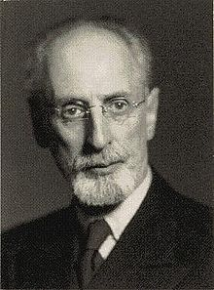
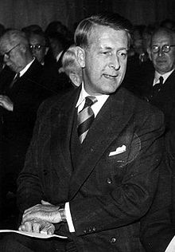
The Answer of Heckscher-Ohlin
Eli Filip Heckscher (1879 –1952)
Bertil Gotthard Ohlin (1899 –1979 )

Slide 5
The Answer of Heckscher-Ohlin
In 1930 Ohlin succeeded Heckscher, his teacher, as a professor at the Stockholm School of Economics
In 1933 Ohlin published Interregional and International Trade, built on earlier work by Heckscher and his own doctoral thesis
It is now known as the Heckscher–Ohlin model, one of the standard model economists use to debate trade theory

Slide 6
The Answer of Heckscher-Ohlin
While world trade is partly explained by differences in labor productivity, it also reflects differences in countries’ resources
Canada export forest products to the US not because lumberjacks are relatively more productive but because Canada has more land per capita

Slide 7
The Answer of Heckscher-Ohlin
US exports orange juice to Canada not because its Orange farmers are inherently more productive but because it is endowed with good weather in Florida

Slide 8
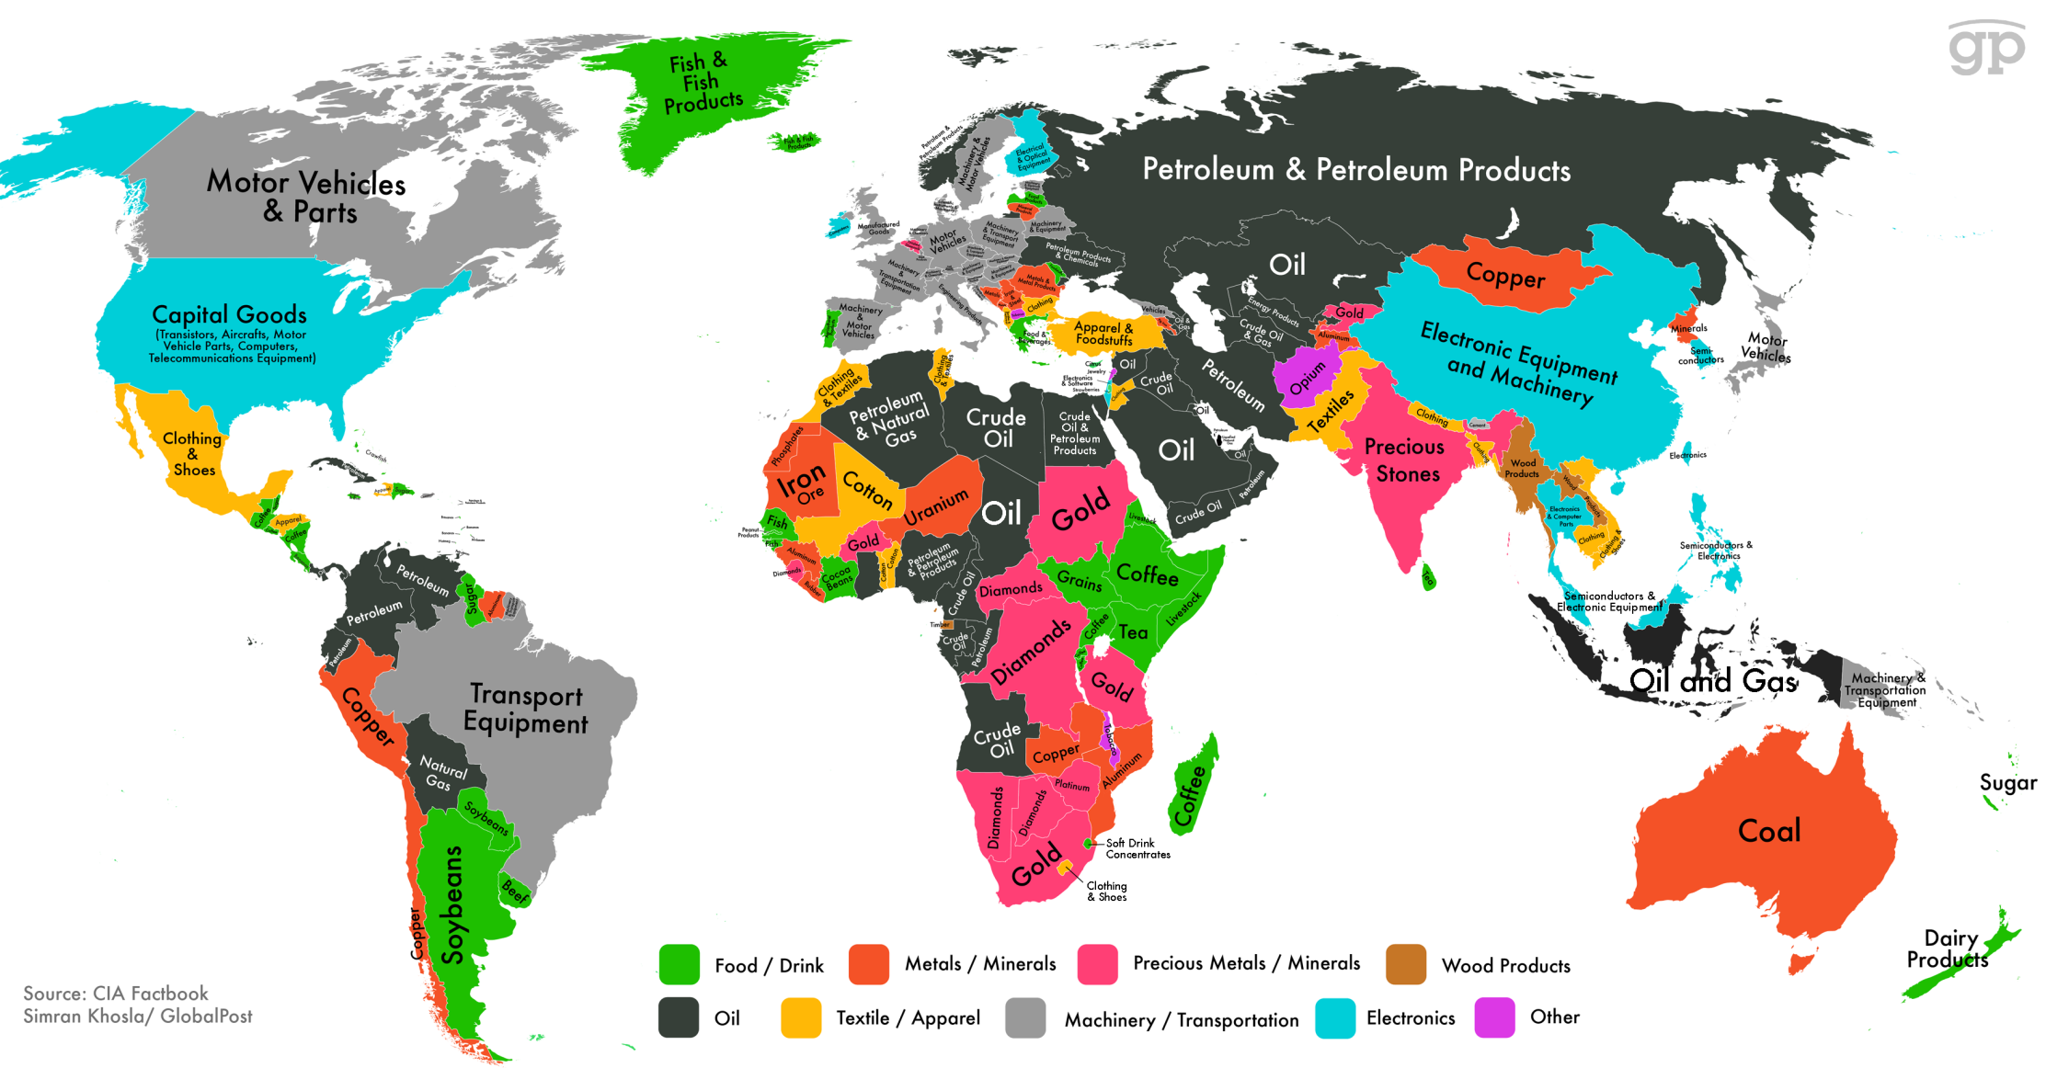
A realistic view of trade must allow for differences in factors of production such as land, capital, and natural resources

Slide 9
The Answer of Heckscher-Ohlin
The Heckscher-Ohlin theory:
Emphasizes resource differences as the only source of trade
Shows that comparative advantage is influenced by:
Relative factor abundance (refers to countries)
Relative factor intensity (refers to goods)

Slide 10
Heckscher-Ohlin model
We start by describing 2 countries in autarky and look at what happens when they open up

Slide 11
Heckscher-Ohlin model
2 x 2 x 2 model
2 countries, Home and Foreign
2 goods, cloth and food.
The production of these goods requires
2 inputs; labour (L) and capital (K).

Slide 12
Heckscher-Ohlin model
Cloth and food are produced using capital and labour
Production functions:
Q_{C} = Q_{C} (K_{C} , L_{C} )
Q_{F} = Q_{F} (K_{F} , L_{F} )

Slide 13
Heckscher-Ohlin model
Unit input used:
a_{KC} = capital used to produce 1 yard of cloth
a_{LC} = labour used to produce 1 yard of cloth
a_{KF} = capital used to produce 1 calorie of food
a_{LF} = labour used to produce 1 calorie of food

Slide 14
Heckscher-Ohlin model
Unit input used:
a_{KC} = capital used to produce 1 yard of cloth
a_{LC} = labour used to produce 1 yard of cloth
a_{KF} = capital used to produce 1 calorie of food
a_{LF} = labour used to produce 1 calorie of food
K is for capital
L is for labour
C is for Cloth
F is for Food

Slide 15
Heckscher-Ohlin model
We speak of the quantity of capital or labour used rather than required, to produce a unit of cloth or food
The reason is that there is some room for choice in the use of inputs
Ex: If you want to produce a car, you can use one machine and you’d only need one worker. But if you use only workers, you need 10 of them.

Slide 16
Heckscher-Ohlin model
Example: Unit input used are fixed
a_{KC} = 2
a_{LC} = 2
a_{KF} = 3
a_{LF} = 1
No factor substitution ☹
Ex: You can’t replace one machine by 10 workers
K = 3000
L = 2000

Slide 17
Heckscher-Ohlin model
Example: Unit input used are fixed
a_{KC} = 2
a_{LC} = 2
a_{KF} = 3
a_{LF} = 1
We have :
(a_{KF} /a_{LF} )> (a_{KC} /a_{LC})
Production of food is capital-intensive
Production of cloth is labour-intensive

Slide 18
Heckscher-Ohlin model
The total machine hours and labour hours used to produce Food and Cloth cannot exceed the total supply
➔ A resource constraint

Slide 19
Heckscher-Ohlin model
The total machine hours and labour hours used to produce Food and Cloth cannot exceed the total supply
We have the following resource constraints
a_{KC} × Q_{C} + a_{KF} × Q_{F} ≤ K
a_{LC} × Q_{C} + a_{LF} × Q_{F} ≤ L
2 Q_{C} + 3 Q_{F} ≤ 3000
2 Q_{C} + Q_{F} ≤ 2000

Slide 20
Heckscher-Ohlin model
The total machine hours and labour hours used to produce Food and Cloth cannot exceed the total supply
We have the following resource constraints
a_{KC} × Q_{C} + a_{KF} × Q_{F} ≤ K
a_{LC} × Q_{C} + a_{LF} × Q_{F} ≤ L
2 Q_{C} + 3 Q_{F} ≤ 3000
2 Q_{C} + Q_{F} ≤ 2000
Machines used in cloth production

Slide 21
Heckscher-Ohlin model
The total machine hours and labour hours used to produce Food and Cloth cannot exceed the total supply
We have the following resource constraints
a_{KC} × Q_{C} + a_{KF} × Q_{F} ≤ K
a_{LC} × Q_{C} + a_{LF} × Q_{F} ≤ L
2 Q_{C} + 3 Q_{F} ≤ 3000
2 Q_{C} + Q_{F} ≤ 2000
Machines used in cloth production
Machines used in food production

Slide 22
Heckscher-Ohlin model
The total machine hours and labour hours used to produce Food and Cloth cannot exceed the total supply
We have the following resource constraints
a_{KC} × Q_{C} + a_{KF} × Q_{F} ≤ K
a_{LC} × Q_{C} + a_{LF} × Q_{F} ≤ L
2 Q_{C} + 3 Q_{F} ≤ 3000
2 Q_{C} + Q_{F} ≤ 2000
Total number of Machines
Machines used in cloth production
Machines used in food production

Slide 23
Heckscher-Ohlin model
The total machine hours and labour hours used to produce Food and Cloth cannot exceed the total supply
We have the following resource constraints
a_{KC} × Q_{C} + a_{KF} × Q_{F} ≤ K
a_{LC} × Q_{C} + a_{LF} × Q_{F} ≤ L
2 Q_{C} + 3 Q_{F} ≤ 3000
2 Q_{C} + Q_{F} ≤ 2000
Total number of Machines
Machines used in cloth production
Machines used in food production
Let’s graph this!

Slide 24
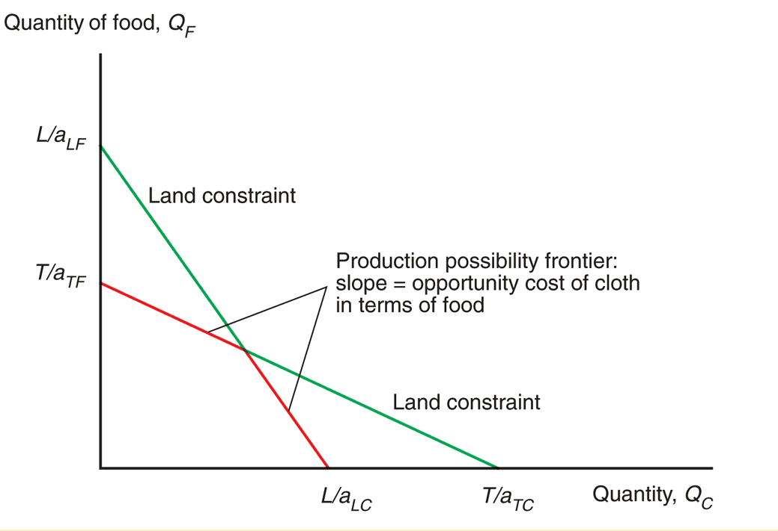
Heckscher-Ohlin model
Production Possibility Frontier
Without factor substitution
Capital constraint: 2 Q_{C} + 3 Q_{F} ≤ 3000
Labour constraint: 2 Q_{C} + Q_{F} ≤ 2000
2000
Labour constraint slope = -2
1
1000
500
3
Capital constraint slope = -2/3
2
750
1000
1500

Slide 25
Heckscher-Ohlin model
Production Possibility Frontier
Without factor substitution
Capital constraint: 2 Q_{C} + 3 Q_{F} ≤ 3000
Labour constraint: 2 Q_{C} + Q_{F} ≤ 2000
2000
Labour constraint slope = -2
1
1000
If all machines are used in cloth: Q_{C} < 1500
500
3
Capital constraint slope = -2/3
2
750
1000
1500

Slide 26
Heckscher-Ohlin model
Production Possibility Frontier
Without factor substitution
Capital constraint: 2 Q_{C} + 3 Q_{F} ≤ 3000
Labour constraint: 2 Q_{C} + Q_{F} ≤ 2000
2000
Labour constraint slope = -2
If all machines are used in Food : Q_{F} < 1000
1
1000
If all machines are used in cloth: Q_{C} < 1500
500
3
Capital constraint slope = -2/3
2
750
1000
1500

Slide 27
Heckscher-Ohlin model
Production Possibility Frontier
Without factor substitution
Capital constraint: 2 Q_{C} + 3 Q_{F} ≤ 3000
Labour constraint: 2 Q_{C} + Q_{F} ≤ 2000
2000
Labour constraint slope = -2
If all machines are used in Food : Q_{F} < 1000
1
1000
If all machines are used in cloth: Q_{C} < 1500
500
3
Capital constraint slope = -2/3
2
750
1000
1500

Slide 28
Heckscher-Ohlin model
2000
Labour constraint slope = -2
1
1000
500
3
Capital constraint slope = -2/3
2
750
1000
1500

Slide 29
Heckscher-Ohlin model
2000
Labour constraint slope = -2
1
1000
500
3
Capital constraint slope = -2/3
2
750
1000
1500

Slide 30
Heckscher-Ohlin model
Both constraints bind
2000
Labour constraint slope = -2
1
1000
500
3
Capital constraint slope = -2/3
2
750
1000
1500

Slide 31
Heckscher-Ohlin model
Both constraints bind
2000
Labour constraint slope = -2
1
1000
500
3
Capital constraint slope = -2/3
2
750
1000
1500

Slide 32
Heckscher-Ohlin model
2000
Labour constraint slope = -2
1
1000
500
3
Capital constraint slope = -2/3
2
750
1000
1500

Slide 33
Heckscher-Ohlin model
The PPF is not a straight line (the slope of the PPF changes)
The opportunity cost of cloth in terms of food is NOT constant
The opportunity cost of cloth in terms of food rises as the economy produces more cloth

Slide 34
Heckscher-Ohlin model
The PPF is not a straight line (the slope of the PPF changes)
The opportunity cost of cloth in terms of food is NOT constant
When the economy is producing mostly food, there is spare labour capacity
When the economy is producing mostly cloth, there is spare capital capacity

Slide 35
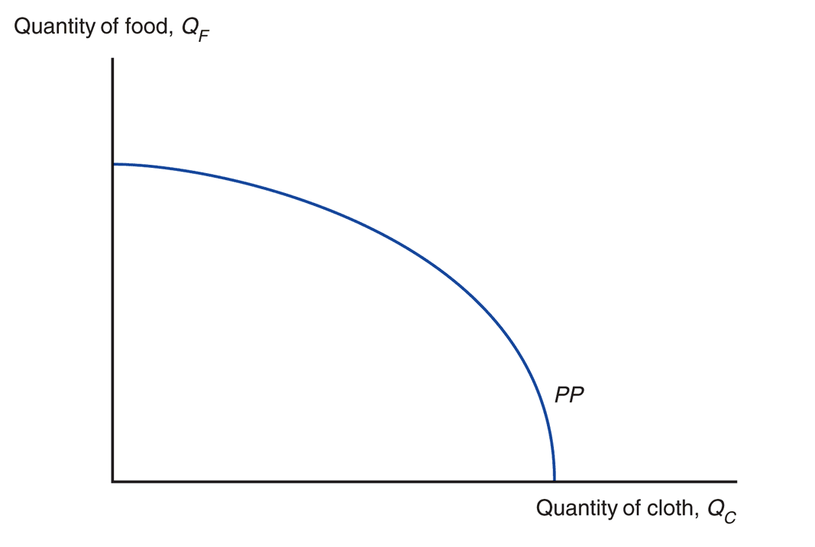
Heckscher-Ohlin model
Let’s now say that substituting labour for capital and vice versa is possible ☺

Slide 36
Heckscher-Ohlin model
Let’s now say that substituting labour for capital and vice versa is possible ☺
This removes the kink in the PPF

Slide 37
Heckscher-Ohlin model
Recap: In the HO model, we have this PPF

Slide 38
Heckscher-Ohlin model
What output mix does the economy produce?
Where am I on the PPF?
Notes:
What

Slide 39
Heckscher-Ohlin model
What output mix does the economy produce?
It depends on prices!
Maximize value of production (V)
V=P_{C} × Q_{C} + P_{F} × Q_{F}
Notes:
What

Slide 40
Heckscher-Ohlin model
What output mix does the economy produce?
It depends on prices!
Maximize value of production (V)
V=P_{C} × Q_{C} + P_{F} × Q_{F}
We can draw isovalue lines
(along which V is constant)
Notes:
What

Slide 41
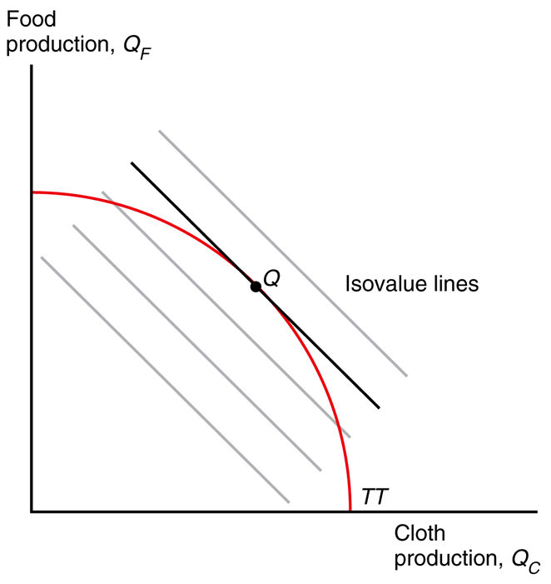
slope = -P_{C} /P_{F}
PP

Slide 42
Wherever you produce on this line, the value of output will be the same
slope = -P_{C} /P_{F}
PP

Slide 43
Opportunity cost = relative prices
at point Q
PP

Slide 44
Opportunity cost = relative prices
at point Q
Remember, that’s the slope of the PPF
PP

Slide 45
Heckscher-Ohlin model
Recap: Countries choose to produce at point Q to maximise the value of output

Slide 46
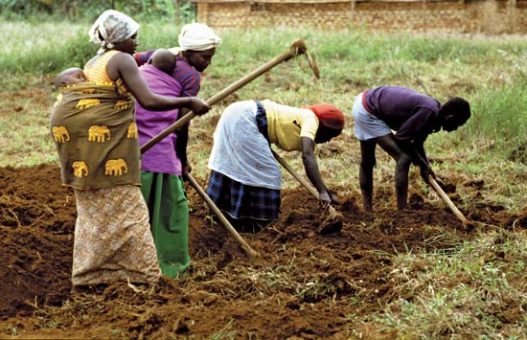
Heckscher-Ohlin model
Choosing the mix of inputs
A farm manager could choose between a tractor or 30 workers with ploughs
He faces trade-offs

Slide 47
Heckscher-Ohlin model
Capital input per calorie, aKF
Input combinations
that produce one
calorie of food
//
Labour input per calorie, aLF

Slide 48
Heckscher-Ohlin model
To produce one calorie, producers can use mostly labour or mostly capital
Capital input per calorie, aKF
Input combinations
that produce one
calorie of food
//
Labour input per calorie, aLF

Slide 49
Heckscher-Ohlin model
Producers do not face fixed input requirements but trade-offs
Capital input per calorie, aKF
Input combinations
that produce one
calorie of food
//
Labour input per calorie, aLF

Slide 50
Heckscher-Ohlin model
Producers do not face fixed input requirements but trade-offs
Capital input per calorie, aKF
Input combinations
that produce one
calorie of food
//
How to choose an input mix?
Labour input per calorie, aLF

Slide 51
Heckscher-Ohlin model
How to choose an input mix?
It depends on the relative costs of labour and capital (w/r)
When wages are relatively high, you replace workers with robots

Slide 52
Heckscher-Ohlin model
How to choose an input mix?
It depends on the relative costs of labour and capital (w/r)
We can graph the relationship between factor prices (w/r) and the L/K mix in food (FF) and cloth (CC) production

Slide 53
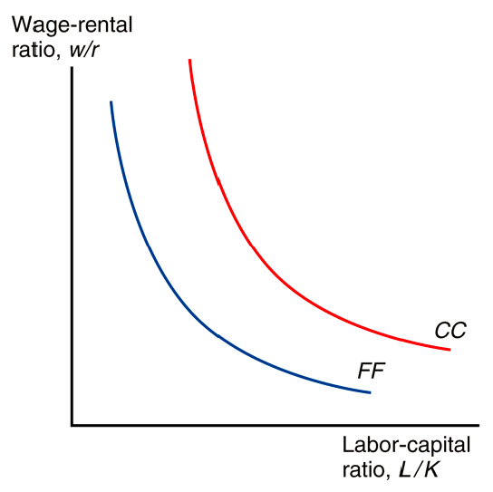
Heckscher-Ohlin model
How to choose an input mix?

Slide 54
Heckscher-Ohlin model
How to choose an input mix?
Cloth

Slide 55
Heckscher-Ohlin model
How to choose an input mix?
Cloth
Food

Slide 56
Heckscher-Ohlin model
How to choose an input mix?
Downward slope ➔
When wages are low, you choose more workers and less robots (less L/K)

Slide 57
Heckscher-Ohlin model
How to choose an input mix?
CC is shifted out
for a given w/r, production of cloth uses more labour
→ cloth is labour-intensive, food is capital-intensive
w/r
L_{F}/K_{F}
L_{c}/K_{c}

Slide 58
Heckscher-Ohlin model
Recap:
An economy chooses an input mix (L/K) that minimises costs (wages and machine rentals)
Relative wages determine the input mix

Slide 59
Heckscher-Ohlin model
How do resources (L/K) affect output?
How different are point Q in countries with different L/K?

Slide 60
Heckscher-Ohlin model
Output of
food, QF
Slope = -PC/PF
TT¹
Q¹F
Q¹C
Output of
cloth, QC

Slide 61
Heckscher-Ohlin model
What if the country had more workers?
Output of
food, QF
Slope = -PC/PF
TT¹
Q¹F
Q¹C
Output of
cloth, QC

Slide 62
Heckscher-Ohlin model
Output of
food, QF
L/K increases
PPF shifts out
TT²
Slope = -PC/PF
TT¹
Q¹F
Q¹C
Output of
cloth, QC

Slide 63
Heckscher-Ohlin model
To understand this shift, go back to how resource constraints are graphed
Output of
food, QF
L/K increases
PPF shifts out
TT²
Slope = -PC/PF
TT¹
Q¹F
Q¹C
Output of
cloth, QC

Slide 64
Heckscher-Ohlin model
To understand this shift, go back to how resource constraints are graphed
Output of
food, QF
L/K increases
PPF shifts out
TT²
Slope = -PC/PF
TT¹
Q¹F
If prices (P_{C}/P_{F}), and hence input mixes, stay constant, what does a country produce?
Q¹C
Output of
cloth, QC

Slide 65
Heckscher-Ohlin model
Output of
food, QF
It produces more of the labour-intensive good (Cloth)
TT²
Slope = -PC/PF
TT¹
1
Q¹F
Slope = -PC/PF
Q²F
2
Q¹C
Q²C
Output of
cloth, QC

Slide 66
Heckscher-Ohlin model
Output of
food, QF
It produces more of the labour-intensive good (Cloth)
TT²
Slope = -PC/PF
At points 1 and 2, the PPF slopes are the same
TT¹
1
Q¹F
Slope = -PC/PF
Q²F
2
Q¹C
Q²C
Output of
cloth, QC

Slide 67
Heckscher-Ohlin model
Recap:
At given prices, a higher L/K means a higher Cloth/Food production
An economy will be relatively effective at producing goods that are intensive in the factors with which it is relatively well endowed

Slide 68
Heckscher-Ohlin model
Suppose that the 2 PPFs are for Home and Foreign
Home is abundant in labor and Foreign is abundant in capital: L/K > L*/ K*
Likewise, Home is scarce in capital and Foreign scarce in labor
Notes:
Rybczynski studied at the LSE and immediately after discovering his famous theorem he spent the rest of his career as an investment banker!

Slide 69
Heckscher-Ohlin model
Suppose that the 2 PPFs are for Home and Foreign
Home is abundant in labor and Foreign is abundant in capital: L/K > L*/ K*
Likewise, Home is scarce in capital and Foreign scarce in labor
* is for Foreign
Notes:
Rybczynski studied at the LSE and immediately after discovering his famous theorem he spent the rest of his career as an investment banker!

Slide 70
Heckscher-Ohlin model
Suppose that the 2 PPFs are for Home and Foreign
Home is abundant in labor and Foreign is abundant in capital: L/K > L*/ K*
Likewise, Home is scarce in capital and Foreign scarce in labor
Because Home is abundant in labor, it will be relatively efficient at producing cloth because cloth is labor-intensive.
This is the Rybczynski effect
Notes:
Rybczynski studied at the LSE and immediately after discovering his famous theorem he spent the rest of his career as an investment banker!

Slide 71
Heckscher-Ohlin model
Abundance is in relative terms!
Example
the total number of workers in the US is about 3 times that in Mexico
But Mexico is labour-abundant relative to the US since the US capital stock is 10 times that in Mexico
No country is abundant in everything!

Slide 72
Trade in the Heckscher-Ohlin model
Trade leads to relative-price convergence
Prices are determined by RS and RD of cloth/food

Slide 73
Trade in the Heckscher-Ohlin model

Slide 74
Trade in the Heckscher-Ohlin model
For a given P_{C} /P_{F} , Home produces relatively more cloth
RS is shifted out

Slide 75
Trade in the Heckscher-Ohlin model
With trade and price convergence, P_{C} /P_{F} moves to point 2, between points 1 and 3

Slide 76
Trade in the Heckscher-Ohlin model
After price convergence, the economy exports the good whose relative price increases

Slide 77
Trade in the Heckscher-Ohlin model
Output of
food, QF
1
Home
Foreign
1
Output of
cloth, QC

Slide 78
Trade in the Heckscher-Ohlin model
Output of
food, QF
1
Home
Foreign
2
2
1
Output of
cloth, QC

Slide 79
Trade in the Heckscher-Ohlin model
With price convergence, PC/PF increases at Home
And PC/PF decreases in Foreign
Output of
food, QF
1
Home
Foreign
2
2
1
Slope = -PC/PF
Output of
cloth, QC

Slide 80
Trade in the Heckscher-Ohlin model
In Home, the rise in the relative price of cloth leads to a rise in the relative production of cloth
Output of
food, QF
1
Home
Foreign
2
2
1
Slope = -PC/PF
Output of
cloth, QC

Slide 81
Trade in the Heckscher-Ohlin model
The decline in the relative price of cloth in Foreign leads it to produce more food and become an exporter of food
Output of
food, QF
1
Home
Foreign
2
2
1
Slope = -PC/PF
Output of
cloth, QC

Slide 82
Trade in the Heckscher-Ohlin model
Recap:
An economy will be relatively efficient at producing goods that are intensive in its abundant factors of production
An economy will export goods that are intensive in its abundant factors
This proposition is called the Heckscher-Ohlin theorem

Slide 83
Trade and the distribution of Income
How do changes in prices affect incomes?

Slide 84
Trade and the distribution of Income
In competitive markets:
Price of each good = cost of production
If food production makes use of very little labour, a rise in wages will not have much effect on the price of food

Slide 85
Trade and the distribution of Income
In competitive markets:
Price of each good = cost of production
If food production makes use of very little labour, a rise in wages will not have much effect on the price of food
If cloth production makes use of a lot of labour, a rise in wages will have a huge effect on the price of cloth
A positive relationship between w/r and P_{C} /P_{F}

Slide 86
Trade and the distribution of Income
A positive relationship between w/r and P_{C} /P_{F}
An increase in the relative price of Cloth increases relative wages

Slide 87
Trade and the distribution of Income
Let’s merge the preceding figure with the one relating factor prices to input choices, i.e. w/r to L/K
We can thus link prices of goods with input mix

Slide 88
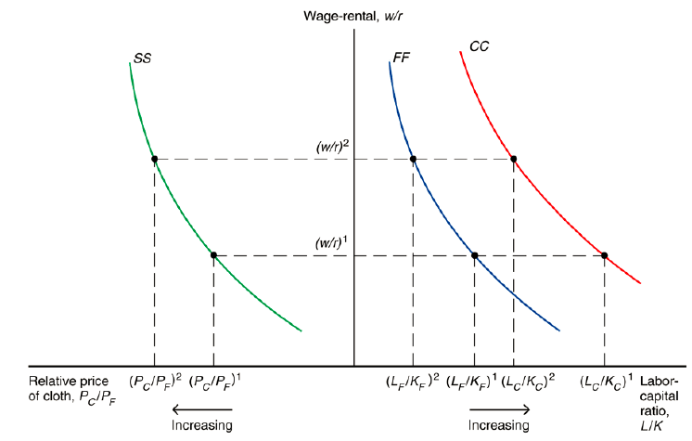
Trade and the distribution of Income

Slide 89
Trade and the distribution of Income
When P_{C} /P_{F} increases, both the production of Food and Cloth uses less L/K

Slide 90
Trade and the distribution of Income
When P_{C} /P_{F} increases, both the production of Food and Cloth uses less L/K
(assume) Marginal productivity of labor increases when L/K decreases… and under competition, real w is equal to the marginal productivity of labour
Notes:
Under competition, w is equal to the marginal productivity of labor
Marginal productivity of labor increases

Slide 91
Trade and the distribution of Income
When P_{C} /P_{F} increases, both the production of Food and Cloth uses less L/K
(assume) Marginal productivity of labor increases when L/K decreases… and under competition, real w is equal to the marginal productivity of labour
We’ll come back to this when we study the specific-factor model
Notes:
Under competition, w is equal to the marginal productivity of labor
Marginal productivity of labor increases

Slide 92
Trade and the distribution of Income
When P_{C} /P_{F} increases, both the production of Food and Cloth uses less L/K
So real wages go up when P_{C} /P_{F} increases
Similarly, real returns to capital fall
(assume) Marginal productivity of labor increases when L/K decreases… and under competition, real w is equal to the marginal productivity of labour
Notes:
Under competition, w is equal to the marginal productivity of labor
Marginal productivity of labor increases

Slide 93
Trade and the distribution of Income
When P_{C} /P_{F} increases, both the production of Food and Cloth uses less L/K
So real wages go up when P_{C} /P_{F} increases
Similarly, real returns to capital fall
(assume) Marginal productivity of labor increases when L/K decreases… and under competition, real w is equal to the marginal productivity of labour
Changes in prices affect the income distribution!
Notes:
Under competition, w is equal to the marginal productivity of labor
Marginal productivity of labor increases

Slide 94
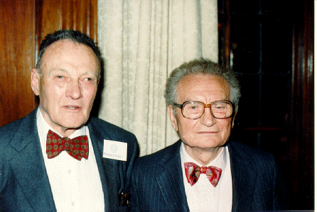
Trade and the distribution of Income
Stolper-Samuelson theorem: if the relative price of a good increases, then the real wage of the factor used intensively in that good increases, while the real return to the other factor decreases

Slide 95
Trade and the distribution of Income
Recap: We have a theory that predicts changes in the distribution of income when the relative price of goods changes

Slide 96
Trade and the distribution of Income
An increase in the relative price of cloth, P_{C} /P_{F} , will:
raise income of workers relative to that of capital owners, w/r.
raise the real income of workers and lower the real income of capital owners
(by raising the ratio of capital to labor, K/L, in both industries and raising the marginal product of labor)

Slide 97
Trade and the distribution of Income
Owners of a country’s abundant factors gain from trade, owners of a country’s scarce factor lose
The UK is capital abundant, opening up to trade hurts labour income

Slide 98
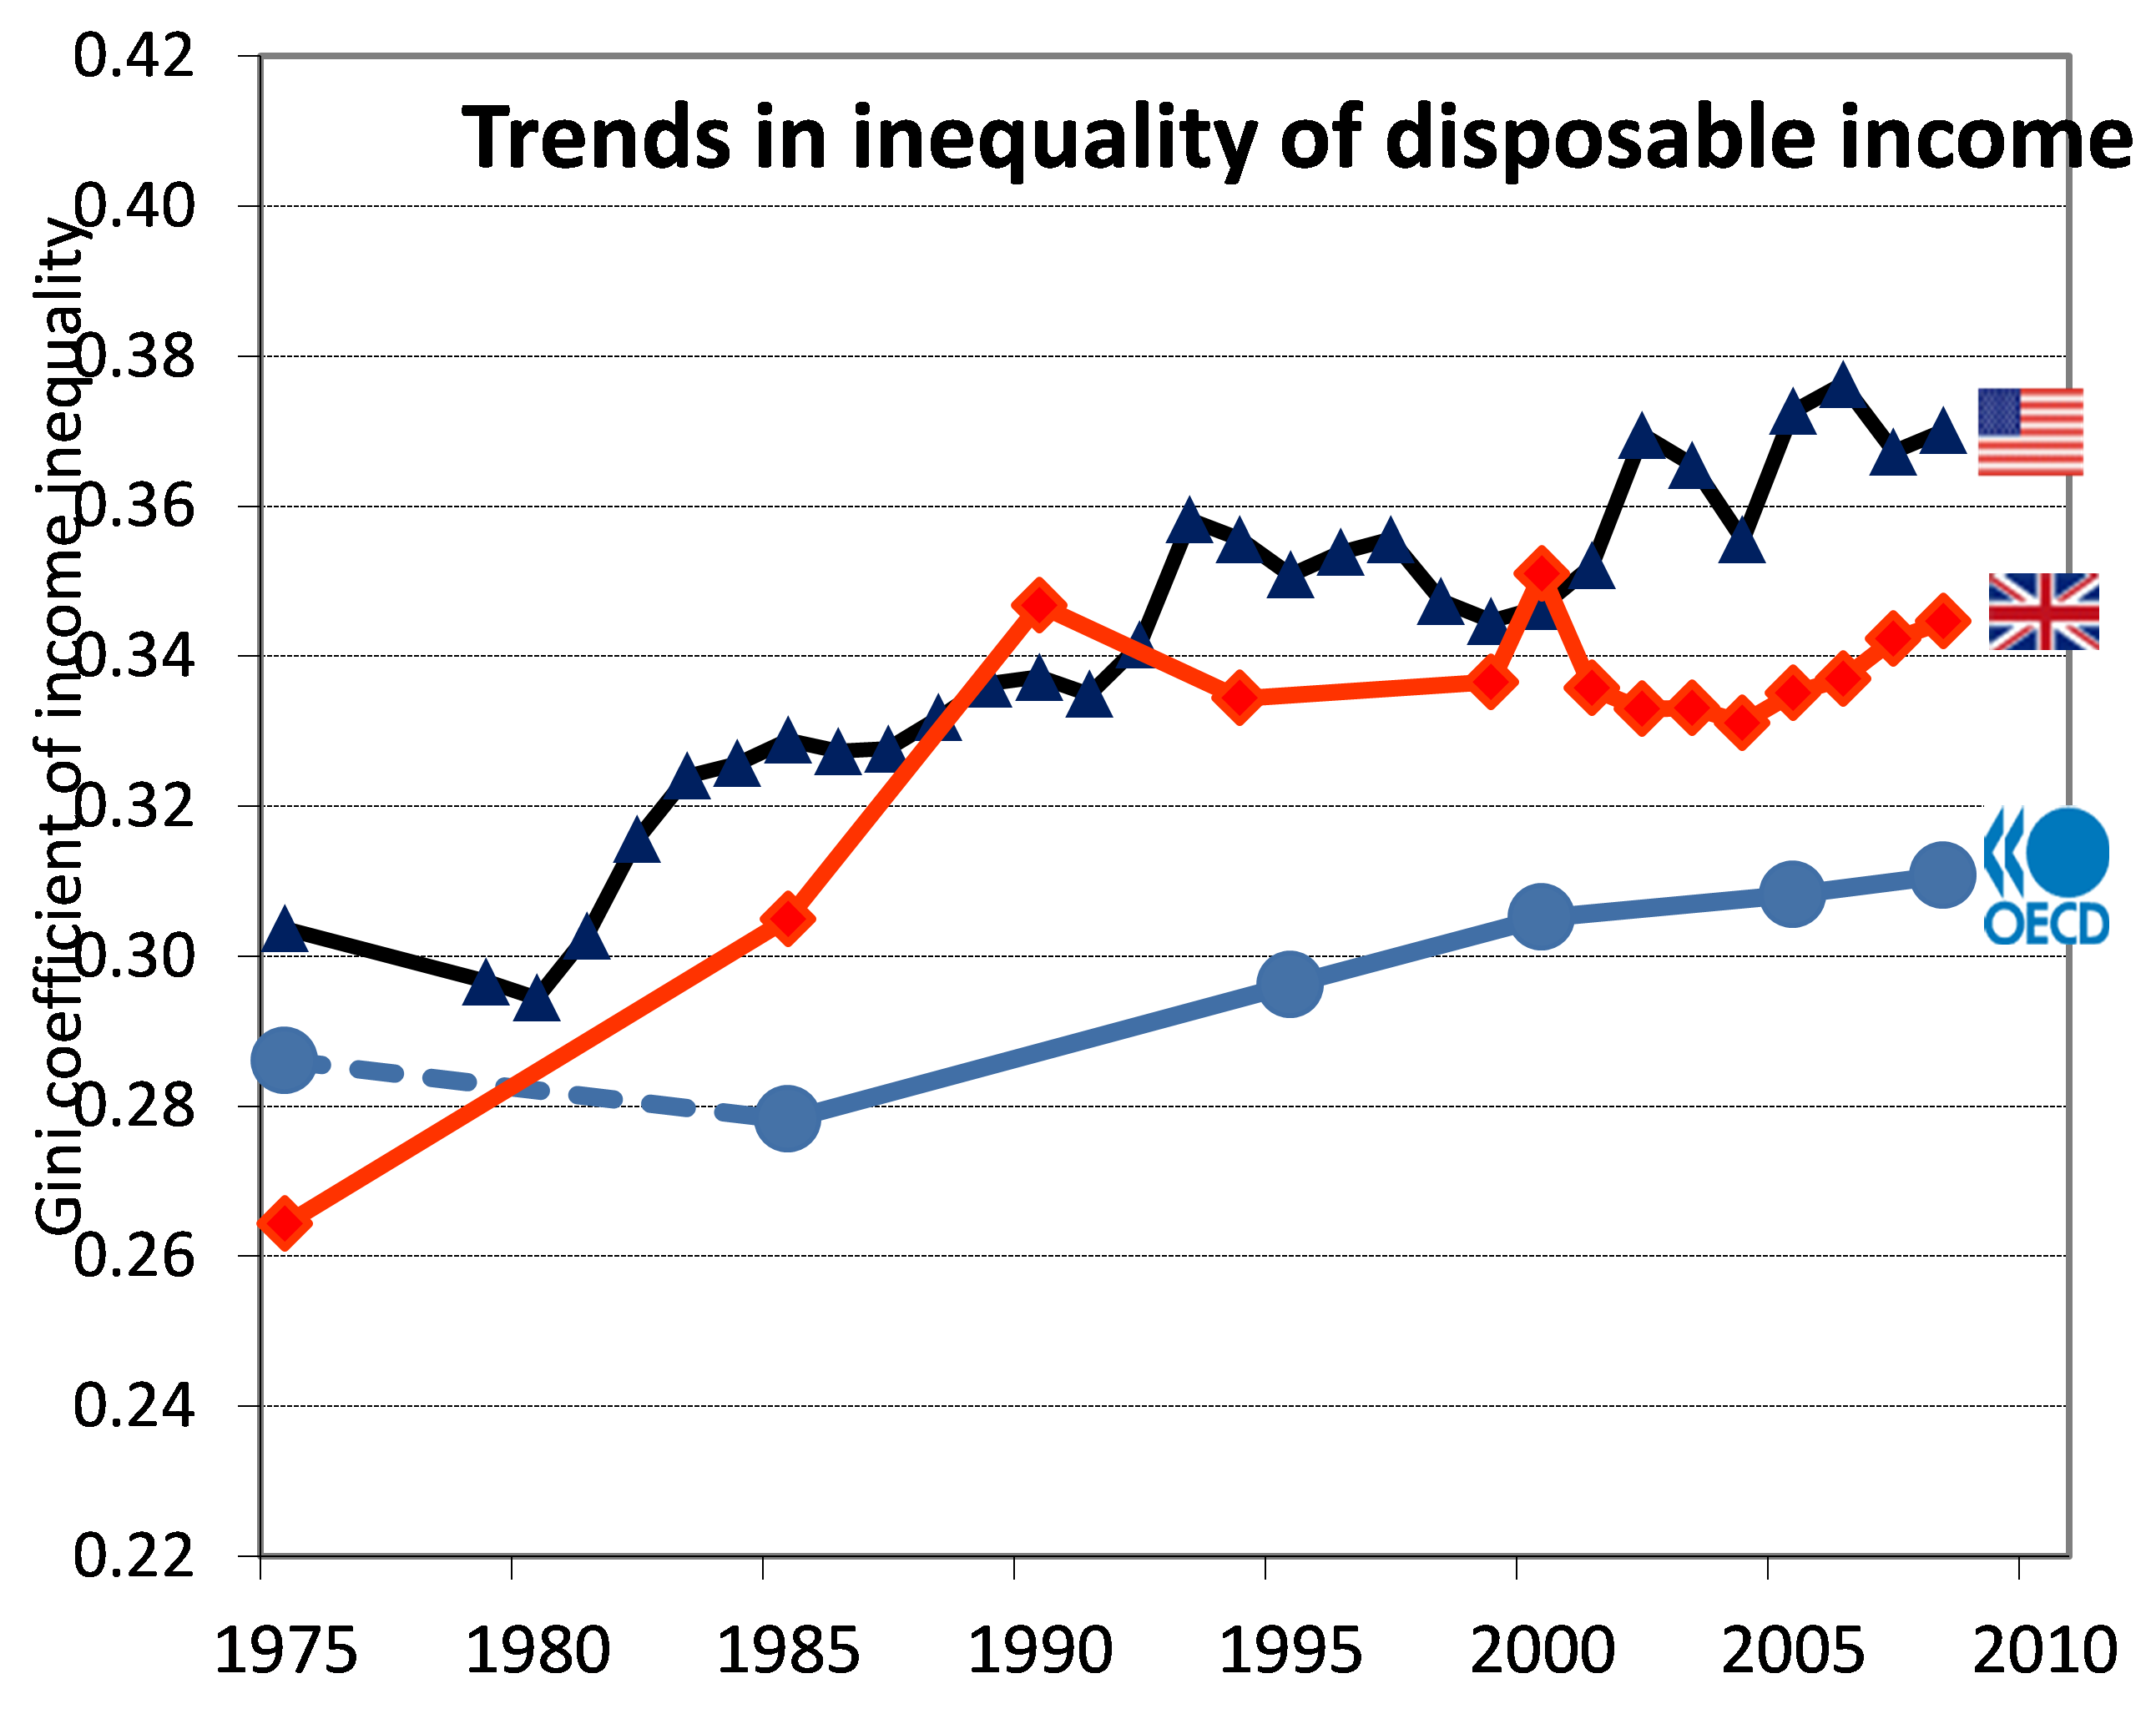
Trade and the distribution of Income

Slide 99
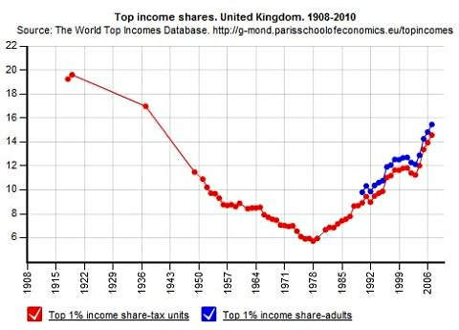
Trade and the distribution of Income

Slide 100
Trade and the distribution of Income
Discuss: In light of what we’ve just learnt about trade theory, do you think trade could have played a role in the rise of inequality in the UK?

Slide 101
Trade and the distribution of Income
Refresher:
Owners of the abundant factor gain from trade integration and owners of the scarce factor lose
This follows from the Heckscher-Ohlin (HO) and the Stolper-Samuelson theorems

Slide 102
Trade and the distribution of Income
Instead of Home and Foreign, consider now the UK and China
Instead of labour and capital, consider now skilled labour and unskilled labour
Instead of cloth and food, consider now high-tech manufactures and low-tech manufactures
Suppose that the UK is skilled-labour abundant and that high-tech manufactures are skilled-labour intensive
What does the Heckscher-Ohlin model predict?

Slide 103
Trade and the distribution of Income
First, the UK should export high-tech manufactures to China and should import low-tech manufactures from China
Second, skilled-labour should gain in the UK and unskilled-labour should lose

Slide 104
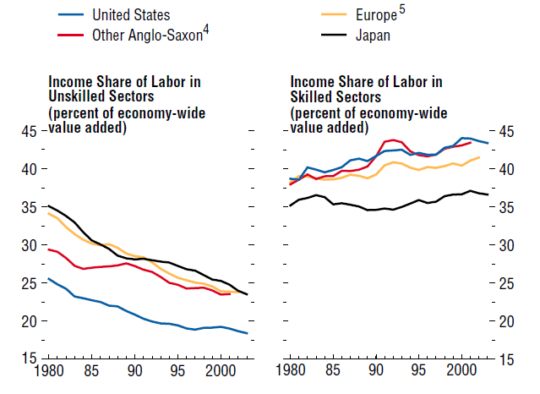
Trade and the distribution of Income
UK and Canada

Slide 105
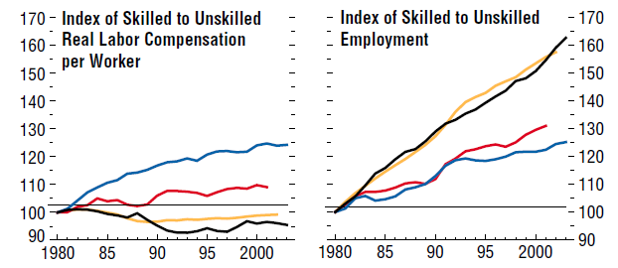
Trade and the distribution of Income
UK and Canada

Slide 106
Trade and the distribution of Income
But the skill premium has also increased in many developing countries
That’s the opposite of what HO predicts
Does it mean that the trade explanation for the increase in inequality in not correct?
Maybe it’s due to technology, not trade?

Slide 107
Krugman’s view on trade and inequality
“The elusive link between trade and wage inequality”
The Economist, Apr 19, 2008.
Krugman had concluded in 1995 that trade with poor countries played only a small role in America's rising wage inequality, explaining perhaps one-tenth of the widening income gap

Slide 108
Krugman’s view on trade and inequality
That was a surprise. In HO theory, trade has substantial effects on the distribution of income
When a country with relatively more capital trades with poorer countries, its workers lose out

Slide 109
Krugman’s view on trade and inequality
In 2007 he wrote on VoxEU.org: "It's no longer safe to assert that trade's impact on the income distribution in wealthy countries is fairly minor”
He offered two reasons why:
First, more of America's trade is with poorer countries, such as China
Second, more tasks have become tradable, increasing the possibility of trade in labour-intensive goods

Slide 110
Factor-price equalization
Prices converge with trade
➔ wages and returns to capital should also converge across countries as under competition the price of each good = cost of production

Slide 111
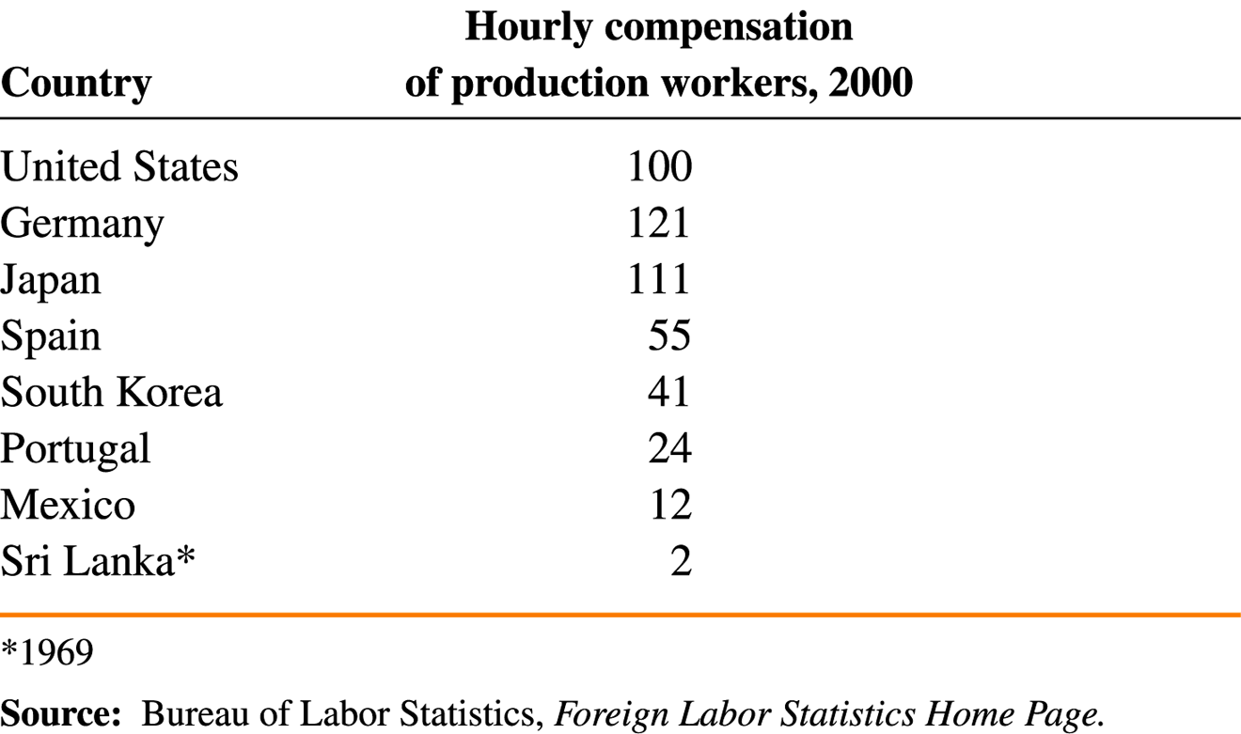
Factor-price equalization
Wages are not equalized in the real world

Slide 112
Factor-price equalization
Not all assumptions of the model hold in reality
The prices of goods don’t converge because of trade costs like shipping costs and import tariffs
Technology is the not the same in all countries

Slide 113
The factor-content of trade
When home and foreign trade, more is happening than a simple exchange of goods
In an indirect way, the 2 countries are trading factors
Home lets foreign use some of its abundant labour
Labour is embedded in Home’s exports

Slide 114
The factor-content of trade
We can calculate how much labour and capital are embedded in goods to see which countries import labour and which import capital
But let’s start with another production factor: water

Slide 115
The factor-content of trade
We can think of water as a production factor
How much water is embedded in goods?
How much virtual water is traded across countries?

Slide 116
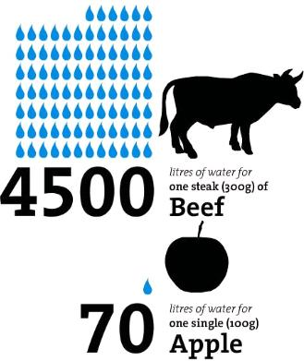
The factor-content of trade

Slide 117
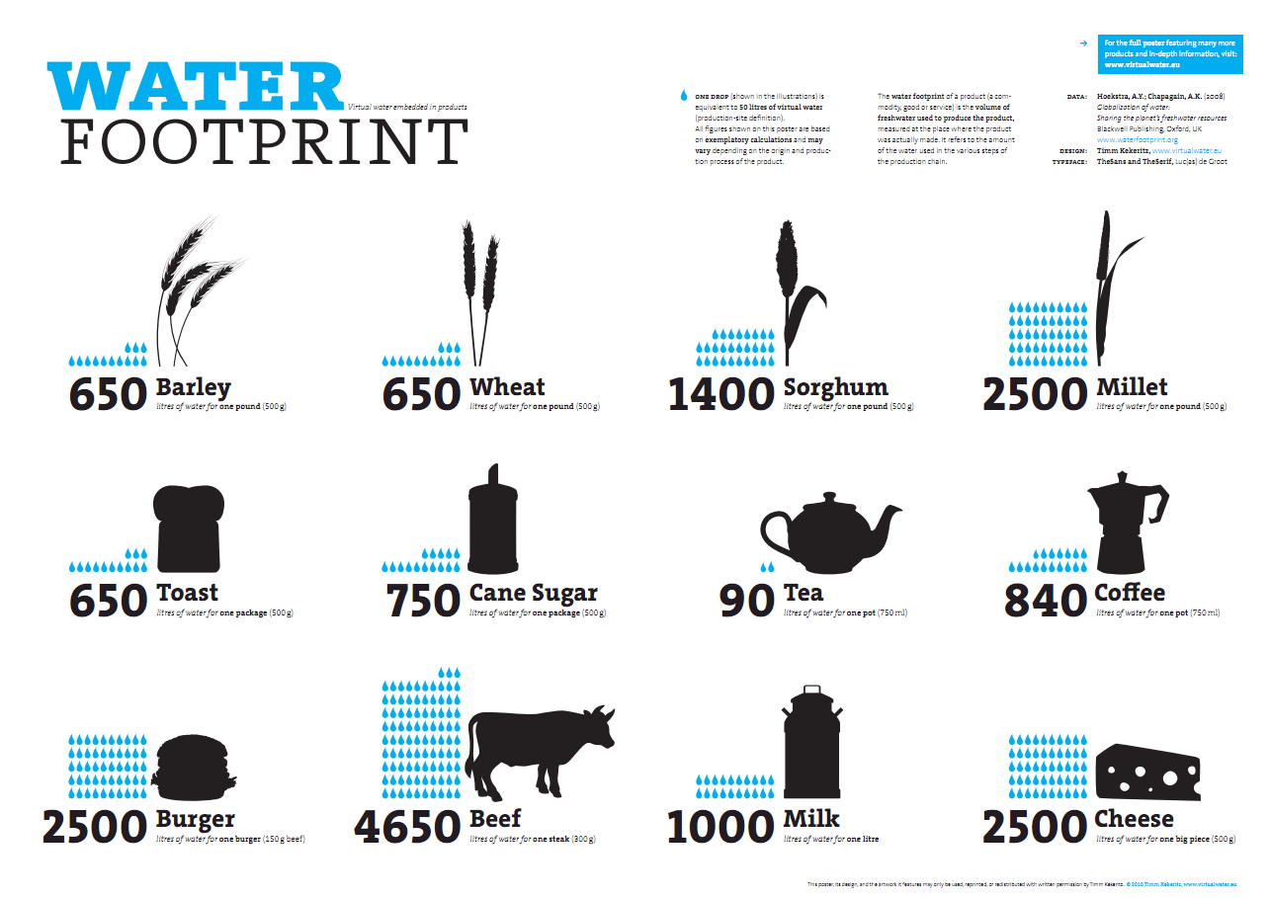
The factor-content of trade
The factor-content of trade

Slide 118
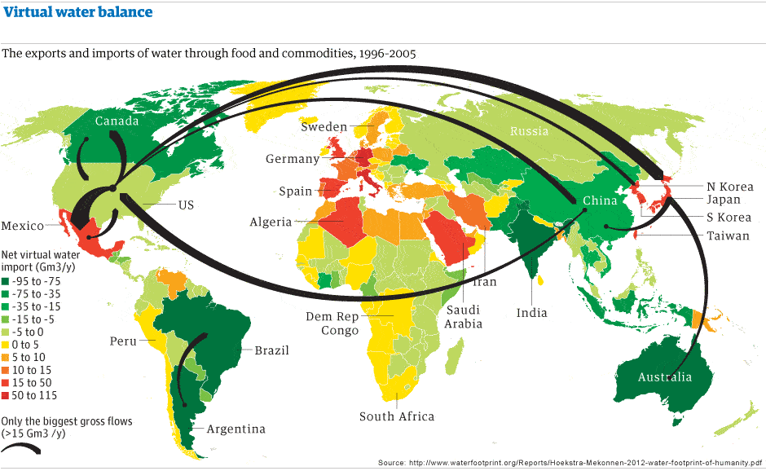
The factor-content of trade

Slide 119
The factor-content of trade
Factor Content of US Exports and Imports, 1962

Slide 120
The factor-content of trade
Factor Content of US Exports and Imports, 1962
US exports were less capital-intensive than US imports
even though the US was the most capital-abundant country in the world

Slide 121
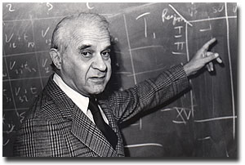
The factor-content of trade
Factor Content of US Exports and Imports, 1962
Leontief paradox
US exports were less capital-intensive than US imports
US exports were less capital-intensive than US imports
even though the US was the most capital-abundant country in the world

Slide 122
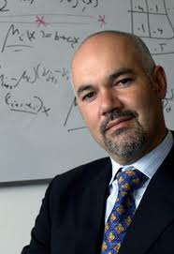
Empirical evidence on the HO model
John Romalis wants to show that skill-abundant countries export skill-intensive products to the US
Here, think of an HO world
where the 2 factors are:
High-skilled workers
Low-skilled workers

Slide 123
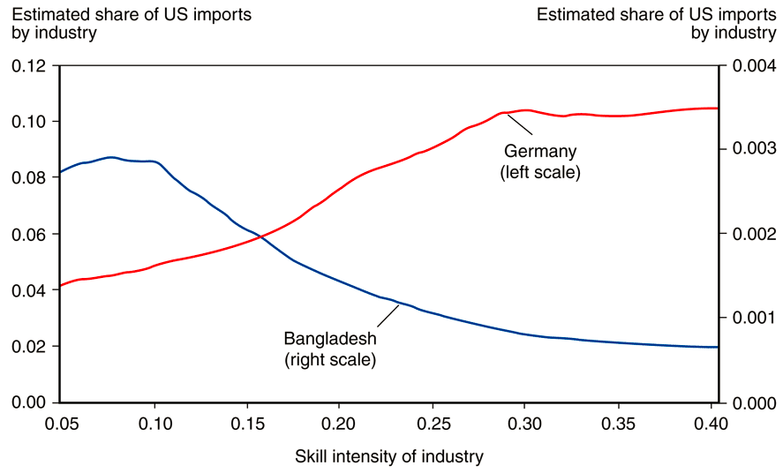
Empirical evidence on the HO model

Slide 124
Empirical evidence on the HO model
US imports from Bangladesh are highest in low-skill-intensity industries, while US imports from Germany are highest in high skill-intensity industries

Slide 125
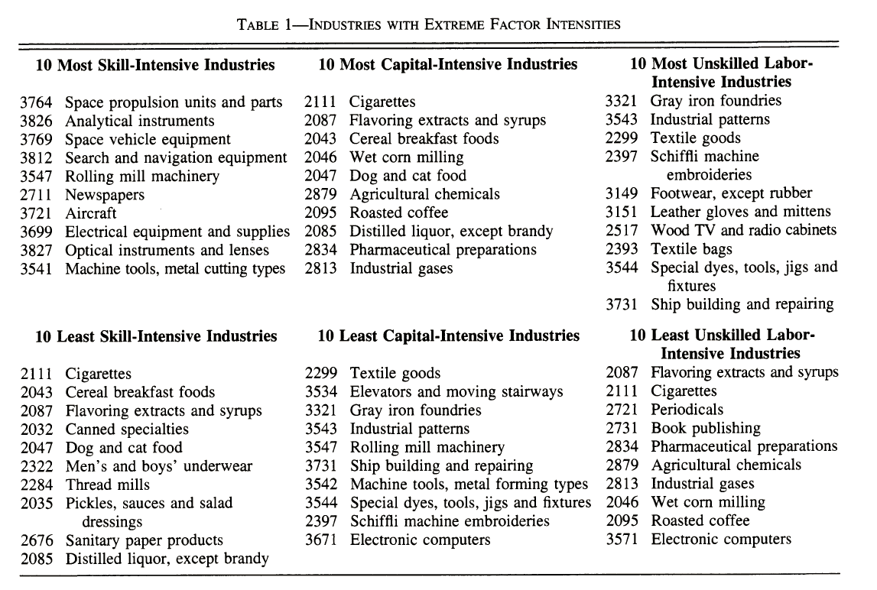

Slide 126
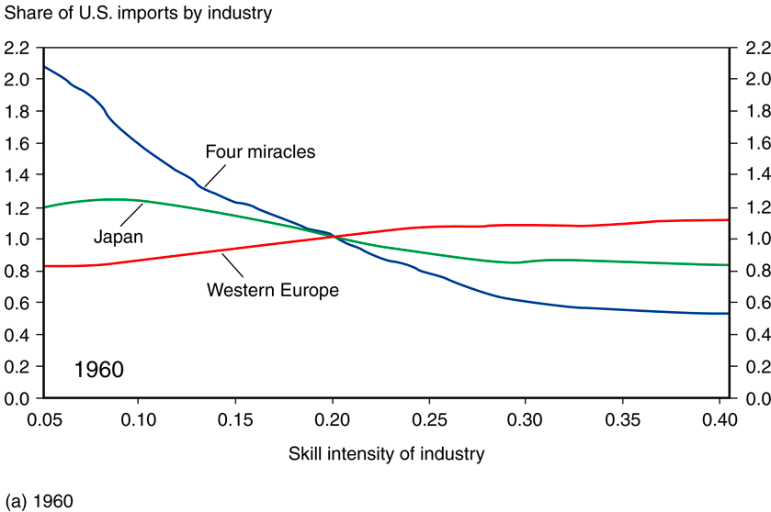
Empirical evidence on the HO model

Slide 127
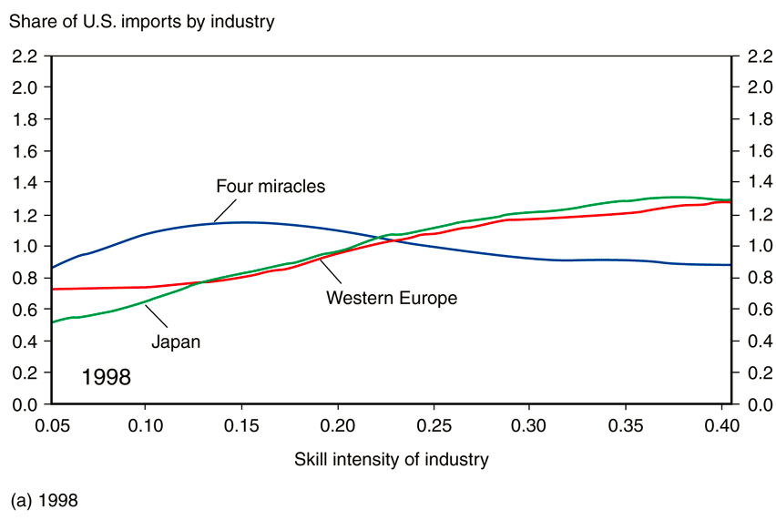
Empirical evidence on the HO model

Slide 128
Empirical evidence on the HO model
That’s the Rybczynski effect!
As Japan and the four Asian “miracle” countries became more skill-abundant, US imports from these countries shifted from less skill-intensive industries toward more skill-intensive industries

Slide 129
Extra readings for the curious!
Romalis, John (2004) "Factor Proportions and the Structure of Commodity Trade". American Economic Review, vol. 94, pp. 67-97.

Slide 130
Hecksher-Ohlin Model
Major Recap:
An economy exports goods that are relatively intensive in its abundant factors of production and imports goods that are relatively intensive in its scarce factors of production
Owners of abundant factors gain, while owners of scarce factors lose with trade

